Slide 1
KDI Assignment Index
Fausto Giunchiglia and Mattia Fumagallli
University of Trento

Slide 2
Outline
Doc(s) index
Topics and Data Sets
Timing
Groups definition

Slide 3
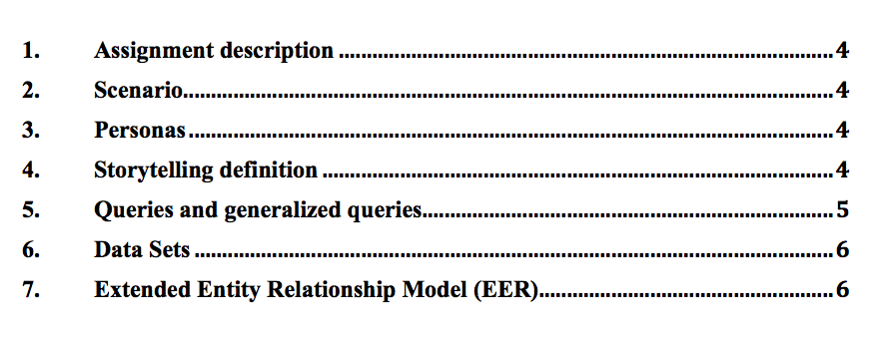
Doc(s) index: Assignment Step 1

Slide 4
Doc(s) index: Assignment Step 2

Slide 5
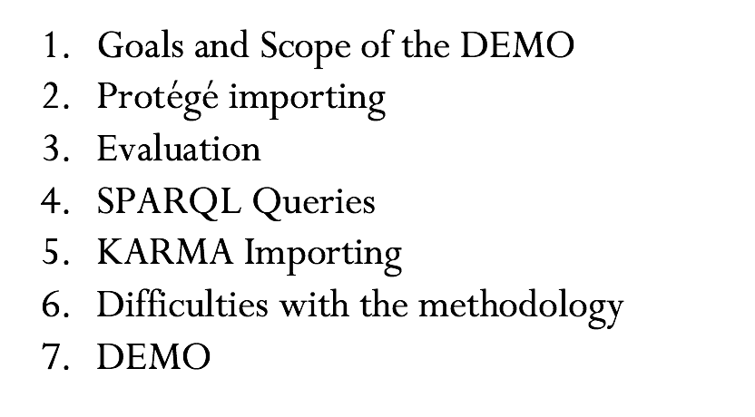
Doc(s) index: Assignment Step 3 - DEMO

Slide 6
Topics and Data Sets (tentative)
TOPIC | DATA SETS
Transportation | https://www.europeandataportal.eu/data/en/dataset?country=gb&groups=transport
Education and communications | https://www.europeandataportal.eu/data/en/dataset?country=gb&groups=education-culture-and-sport
Health | https://www.europeandataportal.eu/data/en/dataset?country=gb&groups=health
Regions and Cities | https://www.europeandataportal.eu/data/en/dataset?groups=regions-and-cities&country=gb
Environment | https://www.europeandataportal.eu/data/en/dataset?country=gb&groups=environment
Economy and Finance | https://www.europeandataportal.eu/data/en/dataset?country=gb&groups=economy-and-finance

Slide 7
Topics and Data Sets
Select a topic
Go to URL
Apply “CSV” filter
Select 3-5 data sets
Select Assignment Title
Start with Assignment Step 1 doc

Slide 8
Timing
Date 1 – To be defined
Date 2 – To be defined
Date 3 – To be defined

Slide 9
Groups definition
Assignments and students selection
(max 2/3 per group)

