Slide 1

Linguistic and Knowledge Resources
Vincenzo Maltese
University of Trento
LDKR course 2014

Slide 2
Roadmap
Introduction
Linguistic resources
Knowledge resources
Capturing diversity with the UKC and Entitypedia
The DERA methodology
2

Slide 3
Introduction

Slide 4
Roadmap
Problem: The semantic heterogeneity problem
Solution: Current approaches to interoperability
Ontologies
Linguistic and knowledge resources: what and why
Exercises
4

Slide 5
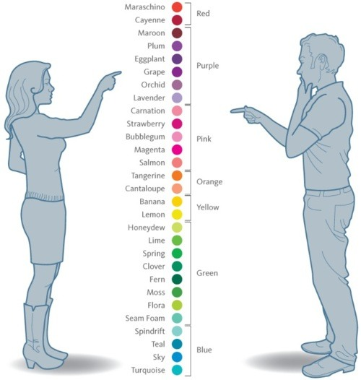
The semantic heterogeneity problem
The difficulty of establishing a certain level of connectivity between people, software agents or IT systems [Uschold & Gruninger, 2004] at the purpose of enabling each of the parties to appropriately understand the exchanged information [Pollock, 2002]
PROBLEM :: SOLUTION :: ONTOLOGIES :: USE-CASES :: EXERCISES
5

Slide 6
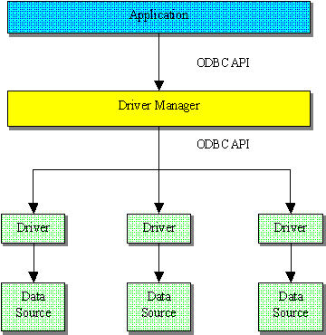
Early solutions
Physical connectivity relies on the presence of a stable communication channel between the parties, for instance ODBC data gateways and software adapters.
Syntactic connectivity is established by instituting a common vocabulary of terms to be used by the parties or by point-to-point bridges that translate messages written in one vocabulary in messages in the other vocabulary.
This rigidity and lack of explicit meaning causes very high maintenance costs (up to 95% of the overall ownership costs) as well as integration failure (up to 88% of the projects) [Pollock, 2002]
PROBLEM :: SOLUTION :: ONTOLOGIES :: USE-CASES :: EXERCISES
6

Slide 7
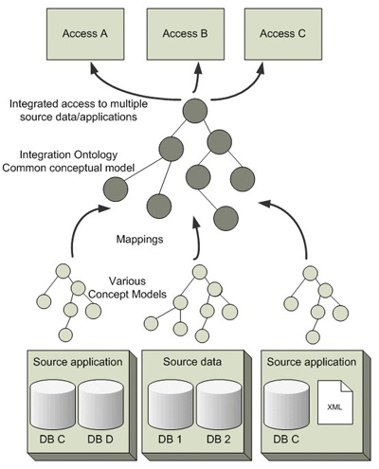
The semantic interoperability solution
The solution in three points:
Semantic mediation: the usage of an ontology, providing a shared vocabulary of terms with explicit meaning.
Semantic mapping: using the ontology, the establishment of a mapping constituted by a set of correspondences between semantically similar data elements independently maintained by the parties.
Context sensitivity: the mapping has contextual validity, i.e. it has to be used by taking into account the conditions and the purposes for which it was generated.
PROBLEM :: SOLUTION :: ONTOLOGIES :: USE-CASES :: EXERCISES
7

Slide 8
Ontologies
An explicit specification of a shared conceptualization [Gruber, 1993]
Directed graphs
Nodes represent concepts
Edges represent relations between concepts
They provide a common (formal) terminology and understanding of a given domain of interest
They allow for automation (logical inference), support reuse and favor interoperability across applications and people.
Animal
Is-a
Is-a
Part-of
Part-of
Bird
Mammal
Head
Body
Is-a
Is-a
Is-a
Chicken
Predator
Herbivore
Eats
Is-a
Is-a
Is-a
Eats
Cat
Tiger
Eats
Goat
PROBLEM :: SOLUTION :: ONTOLOGIES :: USE-CASES :: EXERCISES
8

Slide 9
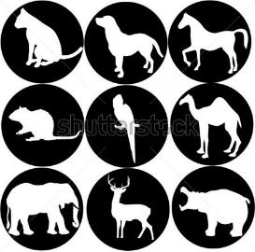

Concepts and relations (I)
CONCEPT: it represents a set of objects or individuals
EXTENSION: the set of individuals is called the concept extension or the concept interpretation
RELATION: a link from the source concept to the target concept
Concepts are often lexically defined, i.e. they have natural language labels which are used to describe the concept extensions, often with an additional description or gloss
ANIMAL
is-a
DOG
PROBLEM :: SOLUTION :: ONTOLOGIES :: USE-CASES :: EXERCISES
9

Slide 10
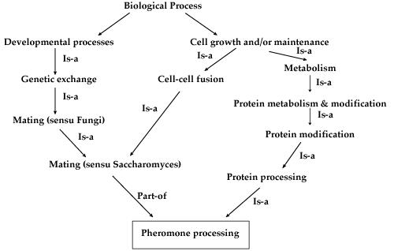
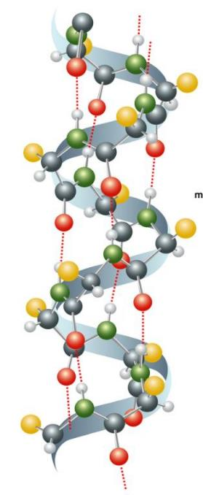
Concepts and relations (II)
The backbone structure of an ontology graph is a taxonomy in which the ontological relations are genus-species (is-a and instance-of) and whole-part (part-of).
PROBLEM :: SOLUTION :: ONTOLOGIES :: USE-CASES :: EXERCISES
10

Slide 11
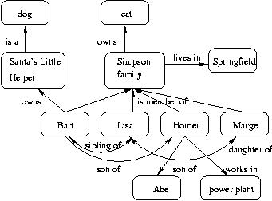

Concepts and relations (III)
The remaining structure of the graph supplies auxiliary information about the modeled domain and may include relations of any kind.
PROBLEM :: SOLUTION :: ONTOLOGIES :: USE-CASES :: EXERCISES
11

Slide 12
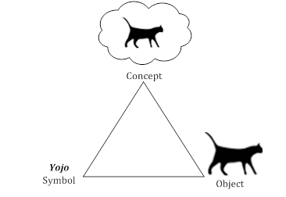
Conceptualization
An abstract model of how people theorize (part of) the world in terms of basic cognitive units called concepts. Concepts represent the intention, i.e. the set of properties that distinguish the concept from others, and summarize the extension, i.e. the set of objects having such properties.
PROBLEM :: SOLUTION :: ONTOLOGIES :: USE-CASES :: EXERCISES
12

Slide 13
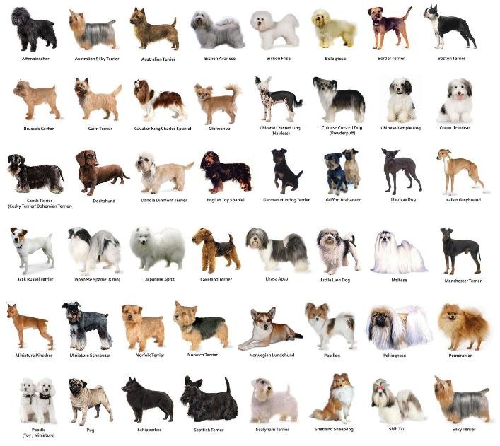
Explicit specification
the abstract model is made explicit by providing names and definitions for the concepts, i.e. the name and the definition of the concept provide a specification of its meaning in relation with other concepts.
DOG
a member of the genus Canis (probably descended from the common wolf) that has been domesticated by man since prehistoric times; occurs in many breeds
PROBLEM :: SOLUTION :: ONTOLOGIES :: USE-CASES :: EXERCISES
13

Slide 14
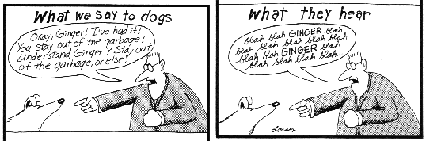
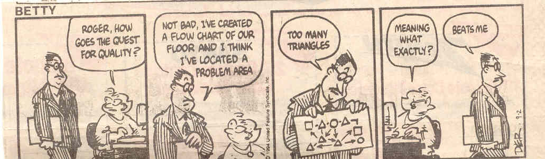
Formal specification
The abstract model is formal when it is written in a language with formal syntax and formal semantics, i.e. in a logic-based language.
PROBLEM :: SOLUTION :: ONTOLOGIES :: USE-CASES :: EXERCISES
14

Slide 15
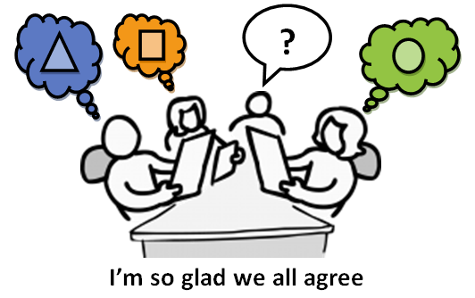
Shared conceptualization
It captures knowledge which is common to a community of people and therefore represents concretely the level of agreement reached in that community.
PROBLEM :: SOLUTION :: ONTOLOGIES :: USE-CASES :: EXERCISES
15

Slide 16
Kinds of ontologies
Ontologies differ according to the purpose, the syntax and the semantics
There is also a tension between expressivity and effectiveness
[Uschold and Gruninger, 2004]
PROBLEM :: SOLUTION :: ONTOLOGIES :: USE-CASES :: EXERCISES
16

Slide 17
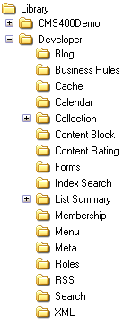
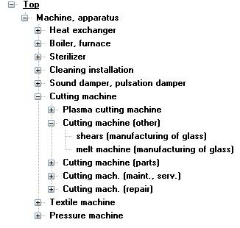
Informal ontologies
User classifications
Folders in a file system
Web directories
Business catalogs
PROBLEM :: SOLUTION :: ONTOLOGIES :: USE-CASES :: EXERCISES
17

Slide 18
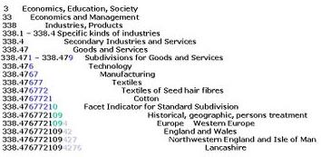
Semi-formal ontologies (I)
Knowledge Organization Systems: Library classifications, Thesauri
PROBLEM :: SOLUTION :: ONTOLOGIES :: USE-CASES :: EXERCISES
18

Slide 19
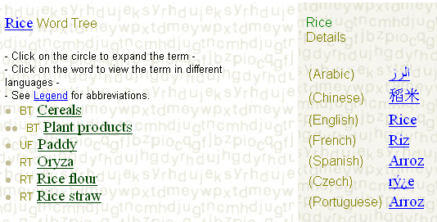
Semi-formal ontologies (II)
In Knowledge Organization Systems (KOS) there are two main kinds of relations: hierarchical (BT/NT) and associative (RT) relations.
PROBLEM :: SOLUTION :: ONTOLOGIES :: USE-CASES :: EXERCISES
19

Slide 20
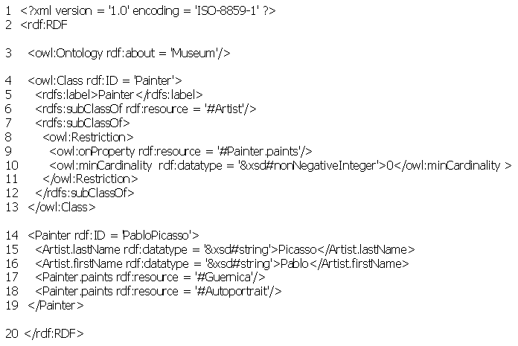
Formal ontologies
  Formal ontologies are expressed into a formal logic language (in syntax and semantics) and represented via formal specifications (e.g. OWL)
PROBLEM :: SOLUTION :: ONTOLOGIES :: USE-CASES :: EXERCISES
20

Slide 21
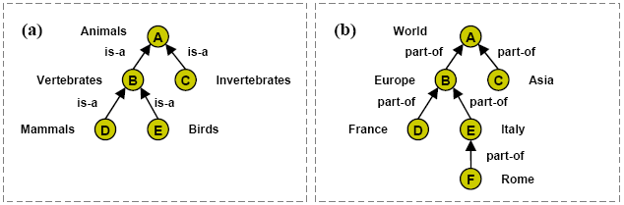
Descriptive ontologies [Giunchiglia et al., 2009]
Used to describe objects in a domain
Real world semantics: the extension of a concept is the set of real world entities about the label of the concept
We need to distinguish between classes (Animals) and individuals (Italy)
Is-a relations are translated into DL subsumption (⊑)
PROBLEM :: SOLUTION :: ONTOLOGIES :: USE-CASES :: EXERCISES
21

Slide 22
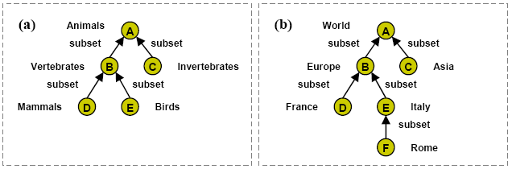
Classification ontologies [Giunchiglia et al., 2009]
Used to categorize objects
Classification semantics: the extension of a concept is the set of documents about the entities or individual objects described by the label of the concept. The semantics of the links is “subset”.
No distinction between classes (Animals) and individuals (Italy)
Subset relations are translated into DL subsumption (⊑)
PROBLEM :: SOLUTION :: ONTOLOGIES :: USE-CASES :: EXERCISES
22

Slide 23
Converting ontologies
From descriptive to classification ontology
convert instances into classes
convert instance-of, is-a and transitive part-of into NT/BT relations
convert other relations into RT relations
From CLASSIFICATION to DESCRIPTIVE ontology
each class is mapped to either a real world class or instance
each NT/BT relation (assuming them to be transitive) has to be converted to either an instance-of, is-a or transitive part-of
each RT relation has to be codified into an appropriate real world associative relation
The translation process can be easily automated
However, with the translation we have a clear loss of information.
The translation process cannot be automated.
It needs significant manual work to reconstruct implicit information.
PROBLEM :: SOLUTION :: ONTOLOGIES :: USE-CASES :: EXERCISES
23

Slide 24
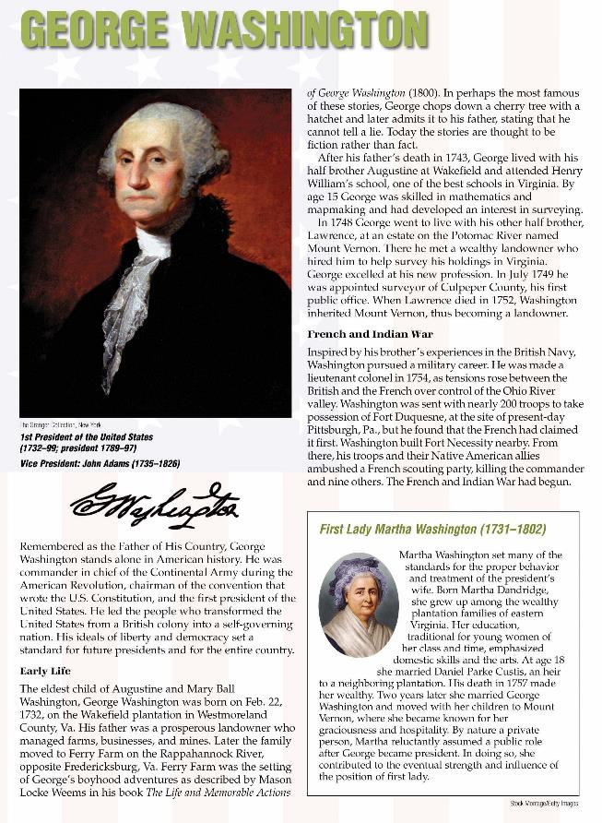
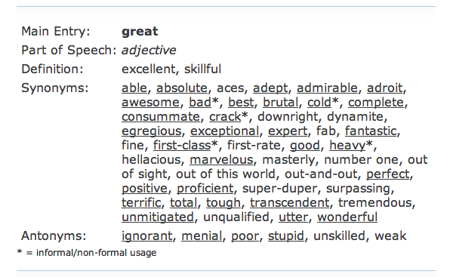
What a linguistic and knowledge resource is?
PROBLEM :: SOLUTION :: ONTOLOGIES :: USE-CASES :: EXERCISES
24

Slide 25
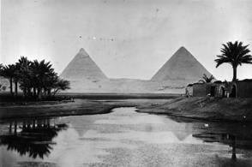
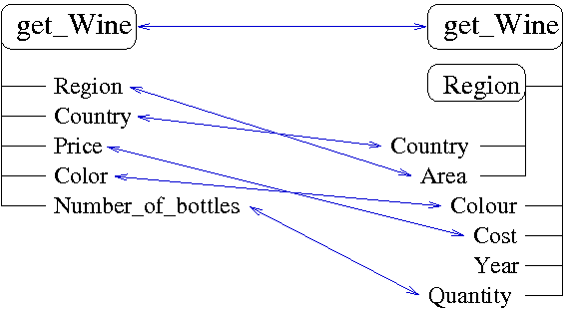
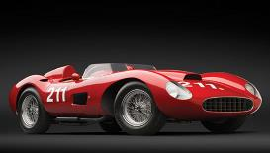
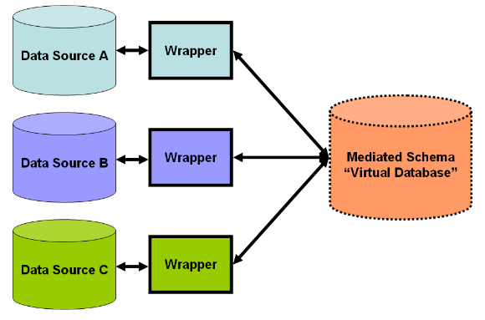
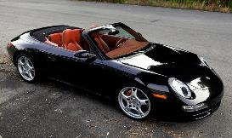
Why do we need linguistic and knowledge resources?
NLP
SEMANTIC MATCHING
The banks of the river Nile
bank: sloping land (especially the slope beside a body of water)
river: a large natural stream of water (larger than a creek)
Nile: a major north-flowing river in northeastern Africa
SEARCH:
automobile
SEMANTIC SEARCH
DATA INTEGRATION
1957 Ferrari 625 TRC Spider
This two-of-a-kind classic Ferrari is lauded by historians as one of the prettiest Ferraris ever built. The 1957 Ferrari 625 TRC Spider is an absolutely stunning automobile, one as dashing in the garage as it is at 120 mph.
Back in the Saddle: Presenting our Porsche 911 (997) Carrera S Cabriolet
There’s a reason the Porsche 911 is one of the most popular sports cars ever, and after a few minutes behind the wheel of one you’ll understand why.
PROBLEM :: SOLUTION :: ONTOLOGIES :: USE-CASES :: EXERCISES
25

Slide 26
Exercises
Is a ER diagram a formal ontology? Explain why yes or no.
Is a database schema a formal ontology? Explain why yes or no.
Create an ontology to describe your family in terms or general classes, relations between them and actual individuals
Identify in the web two thesauri in the agricultural domain
Identify in the web an OWL ontology
Identify a sub-tree in your file system and convert it into a descriptive ontology where each node label is given a definition
PROBLEM :: SOLUTION :: ONTOLOGIES :: USE-CASES :: EXERCISES
26

Slide 27
Linguistic resources

Slide 28
Roadmap
WordNet
MultiWordNet
Weaknesses of existing linguistic resources
Exercises
28

Slide 29
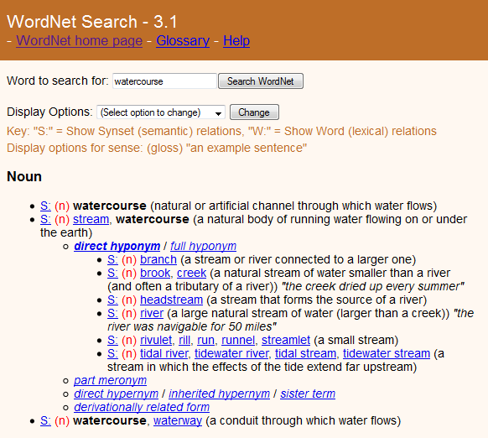
WordNet (1985)
stream
watercourse
word sense
A natural body of running water flowing on or under the earth
synset
hyponym-of
relation
A large natural stream of water (larger than a creek)
river
WORDNET :: MULTIWORDNET :: WEAKNESSES :: EXERCISES
29

Slide 30
Words
Words are the basic constituents of a language
WordNet focuses on lemmas, i.e. the canonical form of a set of words in a language.
  In English, for example, run, runs, ran and running are forms of the same lexeme, with the verb run as the lemma.
WordNet also accounts for exceptional forms. For nouns, they are usually the irregular plural forms, for adjectives and adverbs irregular superlatives, for verbs irregular conjugations.
  For instance, the noun wives is an exceptional form of the noun wife.
WORDNET :: MULTIWORDNET :: WEAKNESSES :: EXERCISES
30

Slide 31
Senses and synsets
A (word) sense is a word in a language (e.g. English) having a distinct meaning.
Senses for each word are ranked.
Words having same sense are grouped together into a synset.
Each synset is associated a part of speech (POS) in the set {noun, adjective, verb, adverb} and a gloss.
  For instance, in English the word good:
  (noun) good : an article for commerce
  (adjective) good : having positive qualities.
WORDNET :: MULTIWORDNET :: WEAKNESSES :: EXERCISES
31

Slide 32
Lexical relations
Lexical relations are between word senses.
Synonymy is a symmetric relation connecting two senses of two different words with same POS and same meaning. WordNet implements synonymy through the notion of synset.
  stream and watercourse are synonym
Antonym is a symmetric relation connecting two senses of two different words with same POS and opposite meaning.
  black is antonym of white.
WORDNET :: MULTIWORDNET :: WEAKNESSES :: EXERCISES
32

Slide 33
Semantic relations
Semantic relations are between synsets.
Y is a hypernym of X (and X is hyponym of Y) if every X is a (kind of) Y
  canine is a hypernym of dog
Y is a meronym of X (and X is holonym of Y) if Y is a part of X
  window is a meronym of building
WORDNET :: MULTIWORDNET :: WEAKNESSES :: EXERCISES
33

Slide 34
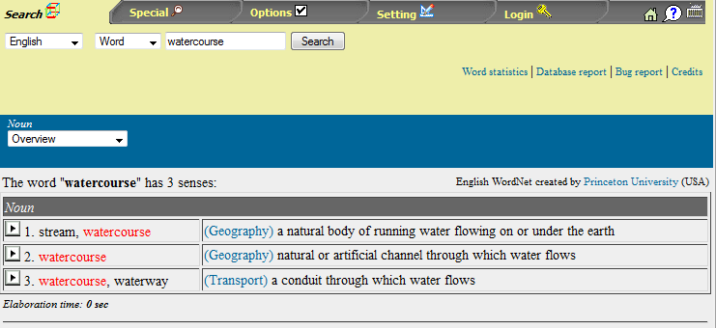
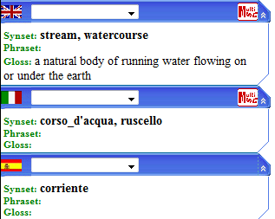
MultiWordNet (2002)
stream
watercourse
A natural body of running water flowing on or under the earth
Mapping via synset IDs
-
corso d’acqua
Strengths
Mapping with 6 languages
Lexical GAPs can be defined
Weaknesses
Only a partial coverage
A few glosses available
Biased towards English
WORDNET :: MULTIWORDNET :: WEAKNESSES :: EXERCISES
34

Slide 35
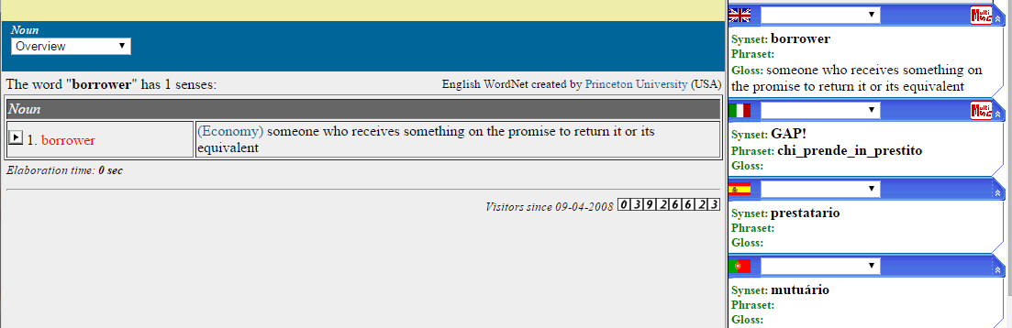
Lexical GAPs and phrasets
The fact that a language (e.g. English) expresses in a lexical unit what the other language (e.g. Italian) expresses with a free combination of words (e.g. borrower = chi prende in prestito)
WORDNET :: MULTIWORDNET :: WEAKNESSES :: EXERCISES
35

Slide 36


Problems with WordNet-like resources (I)
Nodes in similar position do not share same ontological properties
Glosses exhibit space and time bias
Some concepts are too similar in meaning
Some concepts are actually individuals
WORDNET :: MULTIWORDNET :: WEAKNESSES :: EXERCISES
36

Slide 37
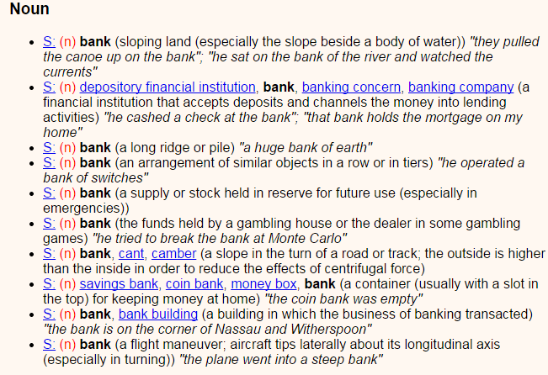
Problems with WordNet-like resources (II)
Polysemy – too fine grained distinctions in meaning
WORDNET :: MULTIWORDNET :: WEAKNESSES :: EXERCISES
37

Slide 38
Exercises
Identify in WordNet two synsets denoting individuals
Identify in WordNet two equivalent synsets, i.e. two synsets having same meaning
Identity in WordNet a word with a polysemy > 10
Identity in WordNet the direct hypernym of «museum»
Identity in WordNet a word with an antonym
Identity in WordNet three cases of space bias and three cases of time bias
Identify in MultiWordNet three words having a GAP in another language
WORDNET :: MULTIWORDNET :: WEAKNESSES :: EXERCISES
38

Slide 39
Knowledge resources

Slide 40
Roadmap
Renowned knowledge resources
The (open) linked data initiative
Applications
Exercises
40

Slide 41



Example of knowledge content
Ulm
Germany
part-of
birth place
CITY
COUNTRY
Albert Einstein
Mileva Maric
date of birth
spouse
March, 14 1879
SCIENTIST
PERSON
affiliation
ETH Zurich
UNIVERSITY
RESOURCES :: LINKED DATA :: APPLICATIONS :: EXERCISES
41

Slide 42
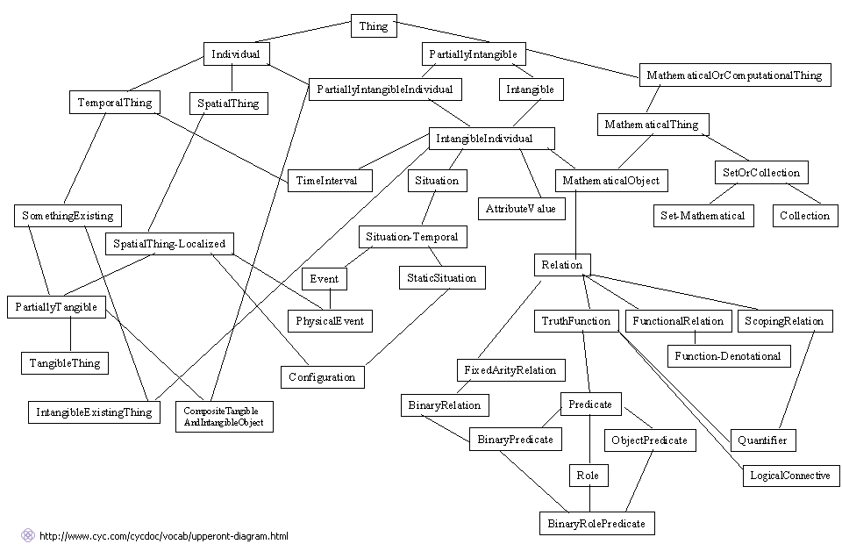
CYC ontology (1984)
Triples such as:
#$isa
#$BillClinton
#$UnitedStatesPresident
#$capitalCity
#$France
#$Paris
A general-purpose common sense knowledge base
Hand-crafted
It contains around 2.2 million assertions and more than 250,000 terms
Content into three levels from broader and abstract knowledge (the upper ontology) and widely used knowledge (the middle ontology) to domain specific knowledge (the lower ontology).
RESOURCES :: LINKED DATA :: APPLICATIONS :: EXERCISES
42

Slide 43
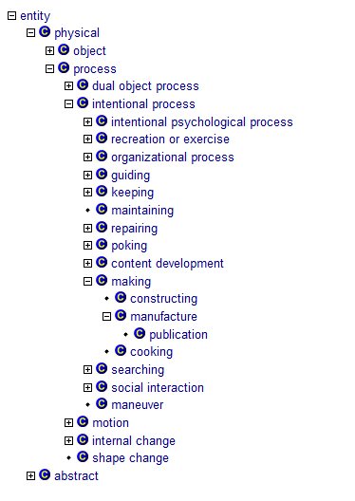
SUMO ontology (2001)
Suggested Upper Merged Ontology
A general-purpose common sense knowledge base
Hand-crafted
It contains around 1,000 terms and 4,000 definitional statements
Its extension, called MILO (Mid-Level Ontology), covers individual domains
RESOURCES :: LINKED DATA :: APPLICATIONS :: EXERCISES
43

Slide 44
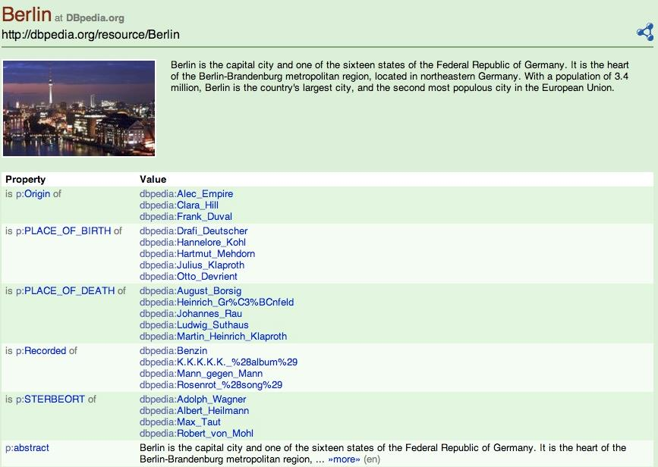
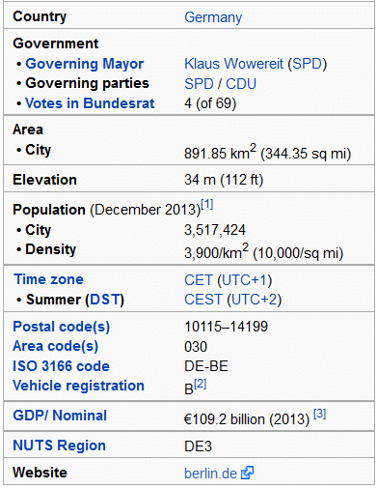
DBPedia (2007)
Wikipedia
It is automatically built by extracting semi-structured content from Wikipedia
Text is not semantically analyzed
RESOURCES :: LINKED DATA :: APPLICATIONS :: EXERCISES
44

Slide 45
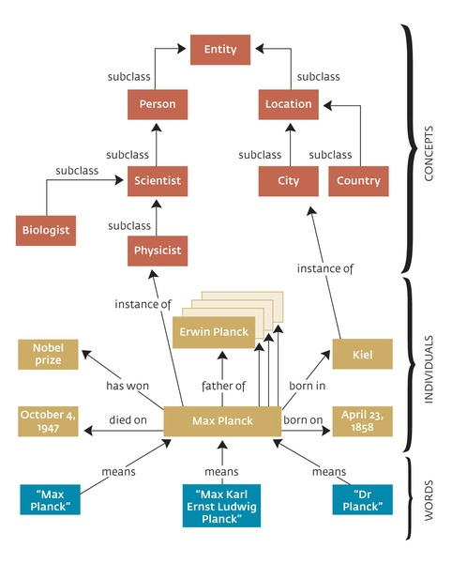
YAGO ontology (2008)
physicist
word
a scientist trained in physics
class
instance-of
Max Planck
instance
Concepts are taken from noun synsets of WordNet
Instances and their properties are automatically extracted from Wikipedia
The linking of concepts with instances is done via NLP techniques
Accuracy is claimed to be ~95%
It is available in triple (RDF) format
RESOURCES :: LINKED DATA :: APPLICATIONS :: EXERCISES
45

Slide 46
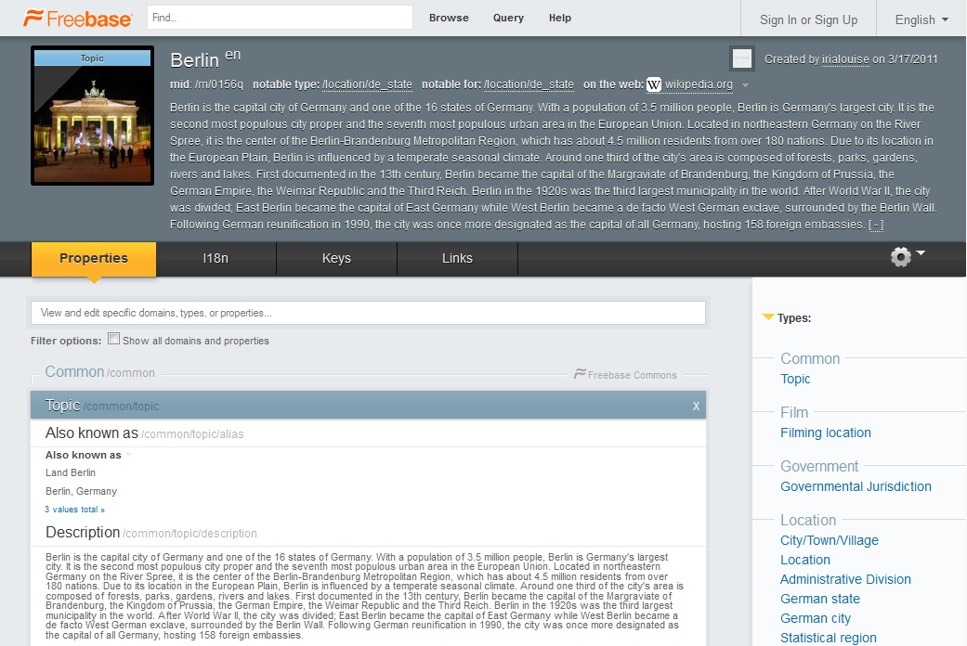
Freebase (2010)
Semi-automatically built
It contains data harvested from several sources such as Wikipedia, NNDB, FMD and MusicBrainz, as well as individually contributed data from its users.
RESOURCES :: LINKED DATA :: APPLICATIONS :: EXERCISES
46

Slide 47
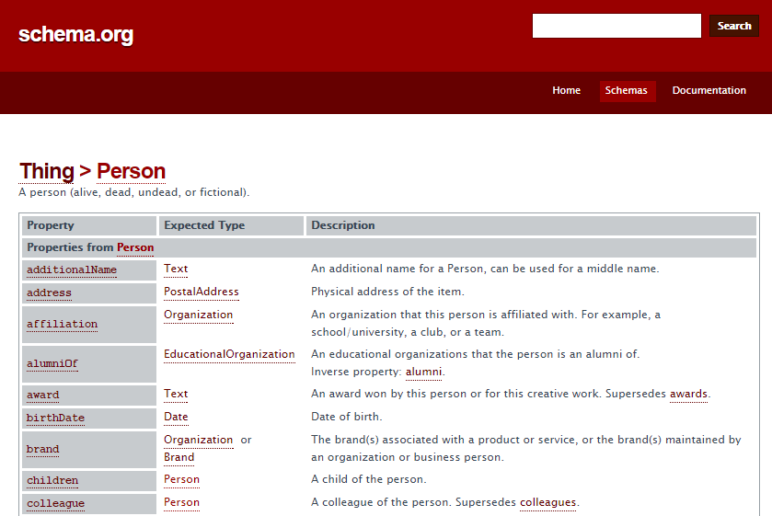
The Schema.org initiative
RESOURCES :: LINKED DATA :: APPLICATIONS :: EXERCISES
47

Slide 48
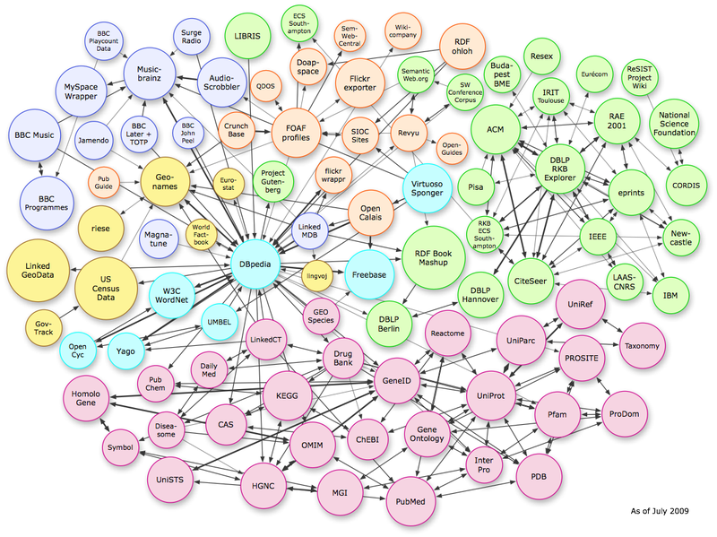
Linked Data Cloud (since 2007)
RESOURCES :: LINKED DATA :: APPLICATIONS :: EXERCISES
48

Slide 49
Linked Data
The Linked Data approach forms the basis of data publishing guidelines pinpointing how data from government, public and private sectors can be more valuable for the consumers.
Principles
  the use of http URIs as the identifiers of things (concepts, entities and attributes)
  the provision of meaningful content published in open format (RDF) for each URI reference
  the production of navigable content via links
RESOURCES :: LINKED DATA :: APPLICATIONS :: EXERCISES
49

Slide 50
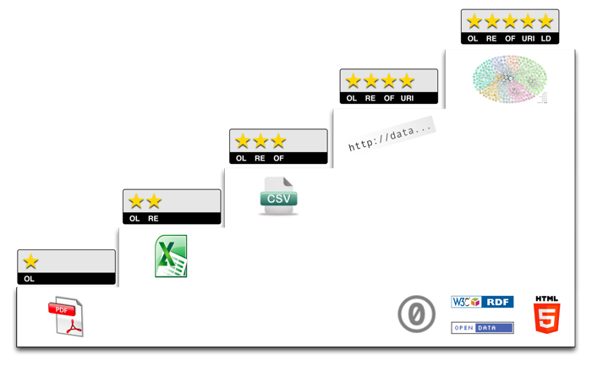

Linked Open Data
links to other RDF
open datasets
W3C open format
(e.g. RDF)
Non-proprietary
format (e.g. CSV)
structured format
publishing on the Web
with an open license
regardless of format
RESOURCES :: LINKED DATA :: APPLICATIONS :: EXERCISES
50
Notes:
water bug – Mangda
The Thai water bugs are about 3 inches long, and look much like a big big version of its North American buddy. The water bugs live in the rice fields and farmers catch them at night by using a light to lure the bugs into a net.
The scent of the bug is important in Thai cuisine, especially in nam prig or chili sauce type of dishes. The wings and head are removed, and the rest of the body, including the legs, are eaten.
Water bugs are very difficult to find at Oriental markets. So far, I can only locate them at a few markets in California. However, the artificial scent is a lot easier to find. It comes in a tiny jar with a dropper wrapped in a tiny box that says "Mangdana essence".

Slide 51
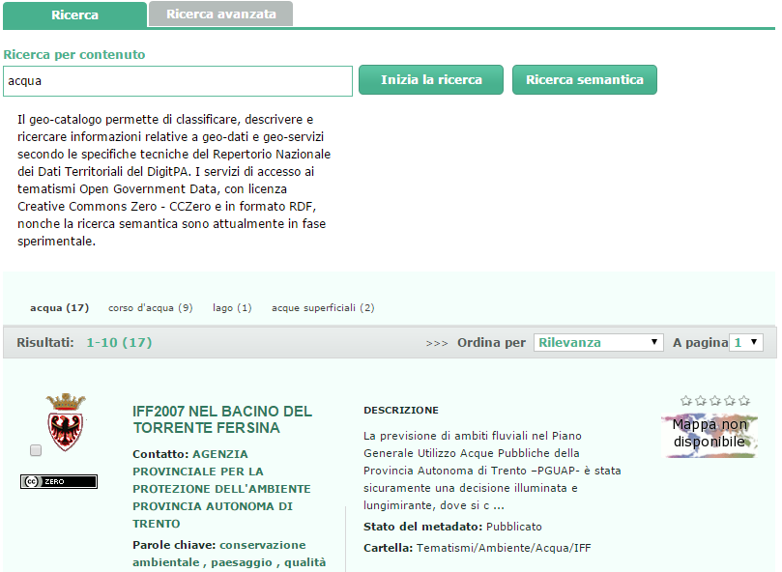
The Semantic Geo-catalogue of the PAT
RESOURCES :: LINKED DATA :: APPLICATIONS :: EXERCISES
51
Notes:
water bug – Mangda
The Thai water bugs are about 3 inches long, and look much like a big big version of its North American buddy. The water bugs live in the rice fields and farmers catch them at night by using a light to lure the bugs into a net.
The scent of the bug is important in Thai cuisine, especially in nam prig or chili sauce type of dishes. The wings and head are removed, and the rest of the body, including the legs, are eaten.
Water bugs are very difficult to find at Oriental markets. So far, I can only locate them at a few markets in California. However, the artificial scent is a lot easier to find. It comes in a tiny jar with a dropper wrapped in a tiny box that says "Mangdana essence".

Slide 52
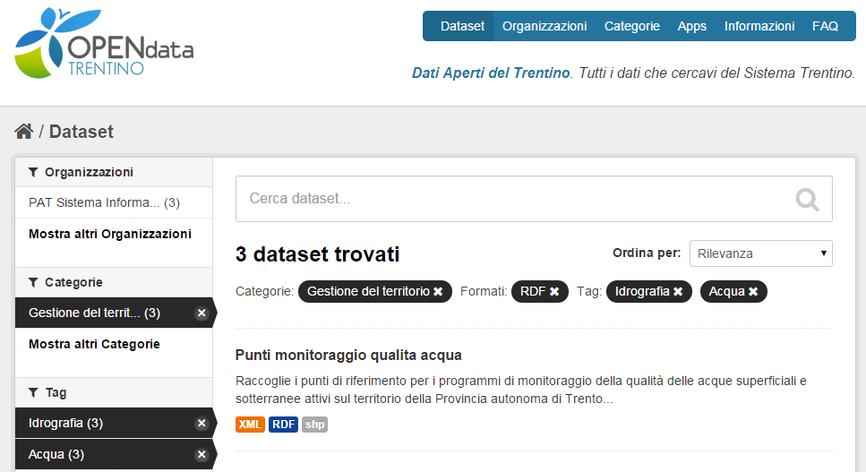
Open Data Trentino portal
RESOURCES :: LINKED DATA :: APPLICATIONS :: EXERCISES
52
Notes:
water bug – Mangda
The Thai water bugs are about 3 inches long, and look much like a big big version of its North American buddy. The water bugs live in the rice fields and farmers catch them at night by using a light to lure the bugs into a net.
The scent of the bug is important in Thai cuisine, especially in nam prig or chili sauce type of dishes. The wings and head are removed, and the rest of the body, including the legs, are eaten.
Water bugs are very difficult to find at Oriental markets. So far, I can only locate them at a few markets in California. However, the artificial scent is a lot easier to find. It comes in a tiny jar with a dropper wrapped in a tiny box that says "Mangdana essence".

Slide 53
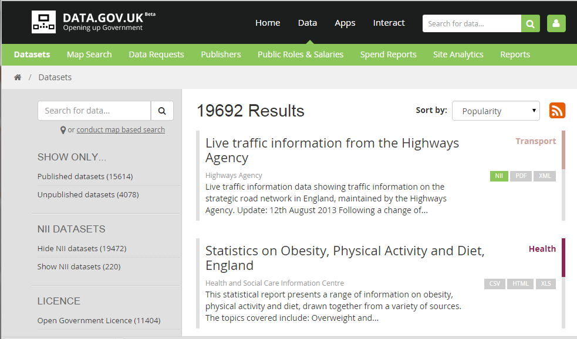
Open Government Data in UK
RESOURCES :: LINKED DATA :: APPLICATIONS :: EXERCISES
53
Notes:
water bug – Mangda
The Thai water bugs are about 3 inches long, and look much like a big big version of its North American buddy. The water bugs live in the rice fields and farmers catch them at night by using a light to lure the bugs into a net.
The scent of the bug is important in Thai cuisine, especially in nam prig or chili sauce type of dishes. The wings and head are removed, and the rest of the body, including the legs, are eaten.
Water bugs are very difficult to find at Oriental markets. So far, I can only locate them at a few markets in California. However, the artificial scent is a lot easier to find. It comes in a tiny jar with a dropper wrapped in a tiny box that says "Mangdana essence".

Slide 54
Exercises
Design two small knowledge graphs about a famous person taking information from Wikipedia, and YAGO (use the YAGO browser)
Explore Freebase and find information about Trento
Explore http://data.gov.uk/ and find useful information about museums
Search for the linked data cloud and check how many datasets it currently contains
RESOURCES :: LINKED DATA :: APPLICATIONS :: EXERCISES
54

Slide 55
Capturing diversity with the UKC and Entitypedia

Slide 56
Roadmap
Diversity and diversity dimensions
The entity-centric approach
The UKC and Entitypedia
Exercises
56

Slide 57

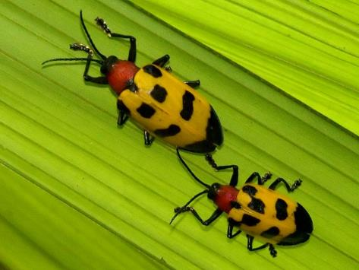
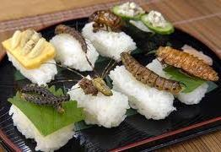
The inherent diversity of the world
What does
bug mean?
COMPUTER
SCIENCE
ENTOMOLOGY
FOOD
… goals, culture, belief, personal experience …
DIVERSITY :: THE APPROACH :: UKC & ENTITYPEDIA :: EXERCISES
57

Slide 58
Diversity is pervasive in world descriptions
Within a natural language
“bug as malfunction” vs. “bug as food” (homonymy)
“stream” and “watercourse” have same meaning (synonymy)
Across natural languages
“watercourse” in English is same as “corso d’acqua” in Italian (concepts)
There is no lemma in Italian for “biking” (lexical GAP)
In formal language
There are several types of bodies of water (semantic relations)
Rivers have a length, lakes have a depth (schematic knowledge)
In data (ground knowledge)
The Adige river is 410 Km long; The Garda lake is 136 m deep
“Bugs are great food” vs. “how can you eat bugs?” (the role of culture)
“Climate is/is not an important issue” (the role of schools of thought)
DIVERSITY :: THE APPROACH :: UKC & ENTITYPEDIA :: EXERCISES
58
Notes:
water bug – Mangda
The Thai water bugs are about 3 inches long, and look much like a big big version of its North American buddy. The water bugs live in the rice fields and farmers catch them at night by using a light to lure the bugs into a net.
The scent of the bug is important in Thai cuisine, especially in nam prig or chili sauce type of dishes. The wings and head are removed, and the rest of the body, including the legs, are eaten.
Water bugs are very difficult to find at Oriental markets. So far, I can only locate them at a few markets in California. However, the artificial scent is a lot easier to find. It comes in a tiny jar with a dropper wrapped in a tiny box that says "Mangdana essence".

Slide 59
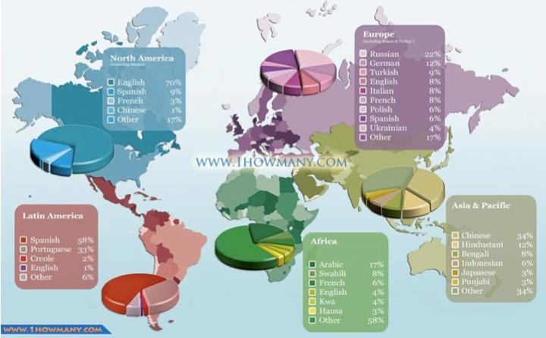
Diversity in Language
Diversity in language
DIVERSITY :: THE APPROACH :: UKC & ENTITYPEDIA :: EXERCISES
59

Slide 60

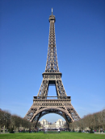
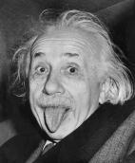

Diversity in Knowledge
Diversity in Knowledge
Billions of locations
Billions of people
Millions of organizations
… and events, artifacts,
creative works, …
DIVERSITY :: THE APPROACH :: UKC & ENTITYPEDIA :: EXERCISES
60

Slide 61


Terminological and ground Knowledge
Actor
acted in
Movie, Film
Michael J. Fox
acted in
Back to the future II
DIVERSITY :: THE APPROACH :: UKC & ENTITYPEDIA :: EXERCISES
61

Slide 62

An entity-centric vision of the world (I)
Entities are objects which are so important in our everyday life to be referred with a name
Each entity has its own attributes (e.g. latitude, longitude, height…)
Each entity is in relation with other entities (e.g. Eiffel Tower is located in Paris, France)
Each entity as a reference class (e.g. monument) which determines its entity type (e.g. location)
Eiffel Tower
DIVERSITY :: THE APPROACH :: UKC & ENTITYPEDIA :: EXERCISES
62

Slide 63
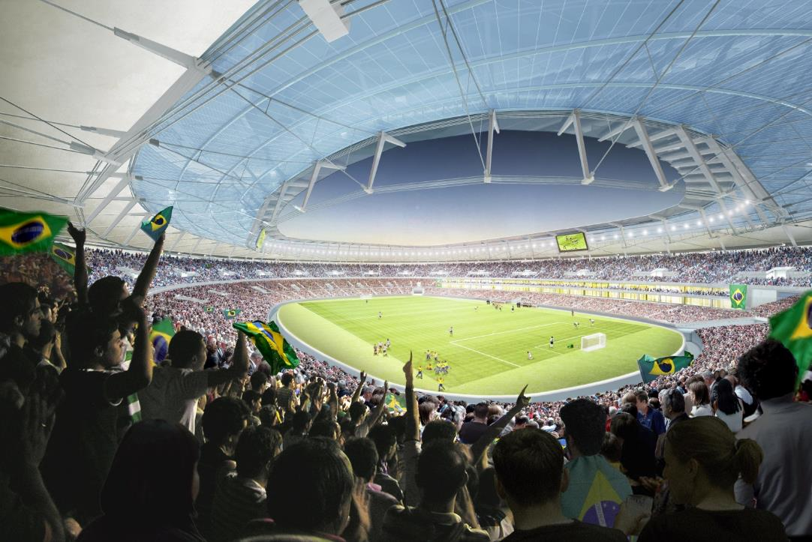
An entity-centric vision of the world (II)
location
event
organization
person
…
Entities are not all the same; they have different metadata according to the type of entity
DIVERSITY :: THE APPROACH :: UKC & ENTITYPEDIA :: EXERCISES
63

Slide 64
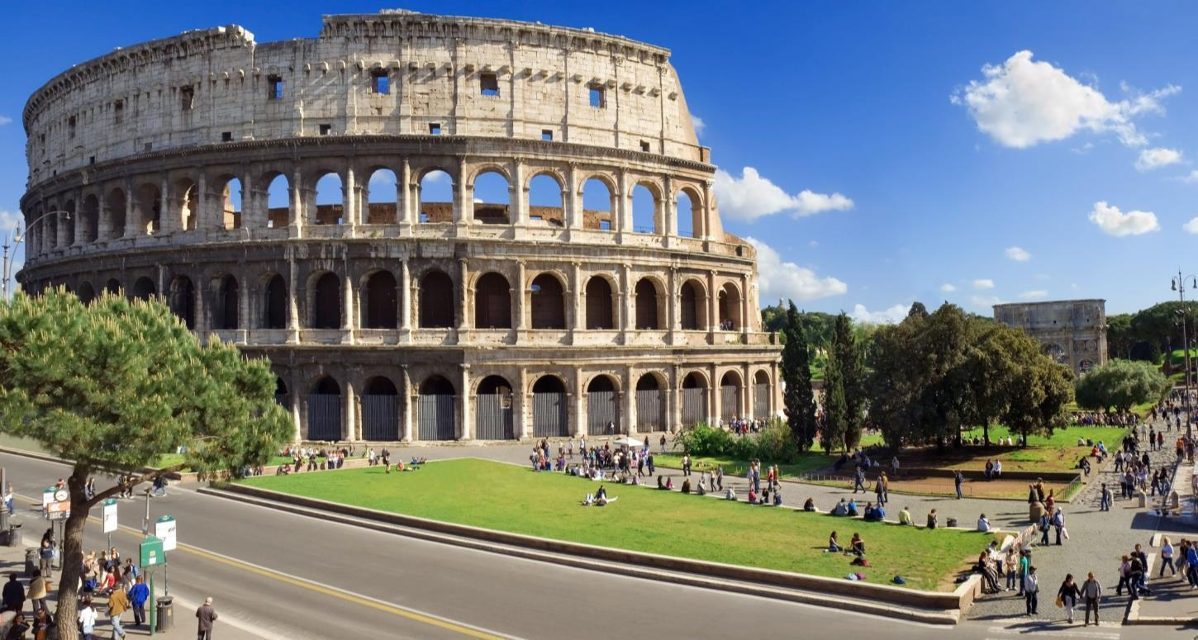
What do we aim to? How to achieve that?
Name: Coliseum
Class: Amphitheatre
Height: 48,5 m
Latitude: 41.89
Longitude: 12.49
Location: Rome
Name: Arch of Constantine
Class: Triumphal arch
Latitude: 41.88
Longitude: 12.49
Location: Rome
Customer: Constantine I
Name: Fori Imperiali
Class: Bus Stop
Company: ATAC
Name: John Doe
Class: Person
Date of Birth: 1960-05-12
DIVERSITY :: THE APPROACH :: UKC & ENTITYPEDIA :: EXERCISES
64
Notes:
Entities are objects which are so important in our everyday life to be referred with a name
Each entity as a reference class (e.g. monument) which determines its entity type (e.g. location)
Each entity is described by its own attributes (e.g. latitude, longitude, height…)
Each entity is described in relation with other entities (e.g. Eiffel Tower is located in Paris, France)
An entity-centric multilingual knowledge base is able to store knowledge (including the profiles of other agents) of a single agent in a CAS (the local view of the world)
Formal models support:
(a) Different agents to describe different real world objects (partiality of knowledge)
(b) The same real world object to be described in different ways and in different languages by different agents (possibly conflicting views)
(c) Agents may describe other agents (multiple profiles of the same agents)
The degree by which agents find an agreement, we have the emergence of social semantics

Slide 65
The UKC and Entitypedia (since 2010)
NATURAL LANGUAGE
EN
FORMAL LANGUAGE
NATURAL LANGUAGE
IT
stream
watercourse
corso d’acqua
A natural body of running water flowing on or under the earth
Uno specchio d’acqua che scorre sulla tera o al di sotto di essa
#123
is-a
A large natural stream of water (larger than a creek)
Un grande corso d’acqua di origine naturale (piu’ grande di un ruscello)
#456
river
fiume
Mississippi River
GROUND KNOWLEDGE
Manually built via collaborative development [Tawfik et al., 2014], bootstrapped from WordNet, MultiWordNet, GeoNames
Split natural language, formal language and ground knowledge [Giunchiglia et al., 2012b]
Domain knowledge is created following the DERA methodology [Giunchiglia et al., 2012a] and principles [Giunchiglia et al., 2009] with distinction between entities, classes, relations, attributes and values
DIVERSITY :: THE APPROACH :: UKC & ENTITYPEDIA :: EXERCISES
65

Slide 66
The UKC components
The natural language: our vocabulary in multiple languages
Natural Language Core (NLC)
The fomal language: our graph of language-independent notions
Concept Core (CC)
Schematic knowledge: Our schema of basic entity types
EType Core (ETC)
Domain knowledge: Domain-specific partition of the language above
Domain Core (DC)
DIVERSITY :: THE APPROACH :: UKC & ENTITYPEDIA :: EXERCISES
66

Slide 67

Concept Core
DIVERSITY :: THE APPROACH :: UKC & ENTITYPEDIA :: EXERCISES
67

Slide 68
Natural Language Core
Language | Synset | Gloss
en | Canal | long and narrow strip of water made for boats or for irrigation
it | canale; naviglio | corso d'acqua artificiale, costruito per l'irrigazione o la navigazione
mn | суваг | усжуулалт эсвэл завинд зориулсан барьсан усны урт нарийн гудамж
bn | খাল | পানির দীর্ঘ এবং সরু ধারা যা সেচ বা নাব্যতার জন্য তৈরি করা হয়েছে
zh | 沟渠; 运河 | 人工水道或人工修缮的河流，用于旅行、航运或灌溉
hi | नहर; कुलिया | सिंचाई, यात्रा आदि के लिए छोटी नदी के रूप में तैयार किया हुआ जलमार्ग
Language | Synset | Gloss
en | Rivulet | A small stream
mn | GAP | छोटी सी धारा
DIVERSITY :: THE APPROACH :: UKC & ENTITYPEDIA :: EXERCISES
68

Slide 69
Etype Core: lattice (sample)
Entity
Abstract Entity
Conference
Physical Entity
Artifact
Location
Organization
Person
Event
Mind Product
Movie
Document
Paper
Session
Presentation
Seminar
Proceedings
Song
Information Object
CORE
Extended
DIVERSITY :: THE APPROACH :: UKC & ENTITYPEDIA :: EXERCISES
69

Slide 70
Domain Core: the DERA methodology
To capture terminology relevant to a specific domain
Based on the faceted approach from Library and Information Science
Terminology can be directly codified into Description Logic
Domain
Entity Classes
Relations
Attributes
D
E
R
A
ARRAY
CATEGORY
FACET
CONCEPT
DIVERSITY :: THE APPROACH :: UKC & ENTITYPEDIA :: EXERCISES
70

Slide 71
Entitypedia compared with existing knowledge bases
KB | #entities | #facts | Domains | Distinction classes and instances | Distinction NL/FL | Manual
CYC | 250K | 2.2 M | Yes | No | No | Yes
OpenCYC | 47k | 306k | Yes | No | No | Yes
SUMO | 1k | 4k | No | Yes | Yes | Yes
MILO | 21k | 74k | Yes | Yes | Yes | Yes
DBPedia | 3.5 M | 500 M | No | No | No | No
YAGO | 2.5 M | 20 M | No | No | No | No
Freebase | 22 M | ? | Yes | Yes | No | Yes
Entitypedia | 10 M | 80 M | Yes | Yes | Yes | Yes
DIVERSITY :: THE APPROACH :: UKC & ENTITYPEDIA :: EXERCISES
71

Slide 72
Exercises
Search on the Web information about how many languages are spoken in Europe and in the whole world.
What is the most widely spoken language in the world?
Provide an example of concept which is heavily cultural dependant.
What are the top level entity types (up to 10) that to you are necessary to codify the whole world knowledge?
What are the main novelties introduced by the UKC and Entitypedia w.r.t. previous approaches?
DIVERSITY :: THE APPROACH :: UKC & ENTITYPEDIA :: EXERCISES
72

Slide 73
Methodologies for content generation

Slide 74
Roadmap
Introduction
  Motivation
  The original faceted approach
Primitive notions in DERA
Steps in the methodology
Guiding principles
Converting DERA ontologies into DL
Applications
Exercises
74

Slide 75

WHY DO WE NEED A METHODOLOGY?
BECAUSE SMALL DIFFERENCES MATTER…
Humans and chimps share a surprising 98.8 percent of their DNA.
How to build ontologies which are of the highest quality possible?
INTRO :: DERA :: STEPS :: PRINCIPLES :: APPLICATIONS :: EXERCISES
75

Slide 76
Methodologies to ontology development
Several methodologies have been developed for the construction and maintenance of ontologies (KR) or controlled vocabularies (KO)
The faceted approach [Ranganathan, 1967] from library science is known to have great benefits in terms of quality and scalability
It is based on the fundamental notions of domain and facets, which allow capturing the different aspects of a domain and allow for an incremental growth.
Originally facets were of 5 types (PMEST): Personality, Matter, Energy, Space, Time.
A key feature is compositionality (meccano property), i.e. the system allows a subject to be constructed by freely combining some basic components (facets).
[D] Medicine
[E] Body Part
. Digestive System
. . Stomach
[P] Disease
. Cancer
. . Carcinoma
. . . Adenocarcinoma
[A] Action
. Treatment
[M] Kind (to be applied to [A] Action)
. Chemotherapy
INTRO :: DERA :: STEPS :: PRINCIPLES :: APPLICATIONS :: EXERCISES
76

Slide 77
The DERA framework
To capture terminology relevant to a specific domain
DERA is faceted as it is inspired to the faceted approach
DERA is a KR approach as it models entities of a domain (D) by their entity classes (E), relations (R) and attributes (A)
Terminology can be directly codified into Description Logic
Domain
Entity Classes
Relations
Attributes
D
E
R
A
ARRAY
CATEGORY
FACET
CONCEPT
INTRO :: DERA :: STEPS :: PRINCIPLES :: APPLICATIONS :: EXERCISES
77

Slide 78



Domains
Any area of knowledge or field of study that we are interested in or that we are communicating about that deals with specific kinds of entities:
Domains are the main means by which the diversity of the world is captured, in terms of language, knowledge and personal experience.
INTRO :: DERA :: STEPS :: PRINCIPLES :: APPLICATIONS :: EXERCISES
78

Slide 79




Primitive notions
Entity: a (digital) description of any real world physical or abstract object so important to be denoted with a proper name. A single person, a place or an organization are all examples of entities.
Entity Class: any set of objects with common characteristics.
Relation: any object property used to connect two entities. Typical examples of relations include part-of, friend-of and affiliated-to.
Attribute: any data property of an entity. Each attribute has a name and one or more values taken from a range of possible values.
INTRO :: DERA :: STEPS :: PRINCIPLES :: APPLICATIONS :: EXERCISES
79

Slide 80
Elements of DERA
A DERA domain is a triple D = <E, R, A> where:
E (for Entity) is a set of facets grouping terms denoting entity classes, whose instances (the entities) have either perceptual or conceptual existence. Terms in these hierarchies are explicitly connected by is-a or part-of relation.
R (for Relation) is a set of facets grouping terms denoting relations between entities. Terms in these hierarchies are connected by is-a relation.
A (for Attribute) is a set of facets grouping terms denoting qualitative/quantitative or descriptive attributes of the entities. We differentiate between attribute names and attribute values such that each attribute name is associated corresponding values. Attribute names are connected by is-a relation, while attribute values are connected to corresponding attribute names by value-of relations.
INTRO :: DERA :: STEPS :: PRINCIPLES :: APPLICATIONS :: EXERCISES
80

Slide 81
DERA facets
DERA provides the language required to describe entities of a certain entity type in a given domain (D)
Language comprises entity classes (E), relations (R) and attributes (A), names and values.
Concepts and semantic relations between them form hierarchies of homogeneous nature called facets, each of them codifying a different aspect of the domain.
Each facet is a descriptive ontology
[Giunchiglia et al., 2014]
ENTITY CLASS Location Landform (is-a) Natural elevation (is-a) Continental elevation (is-a) Mountain (is-a) Hill (is-a) Oceanic elevation (is-a) Seamount (is-a) Submarine hill (is-a) Natural depression (is-a)Continental depression (is-a) Valley (is-a) Trough (is-a) Oceanic depression (is-a) Oceanic valley (is-a) Oceanic trough Body of water (is-a) Flowing body of water (is-a) Stream, Watercourse (is-a) River (is-a) Brook (is-a) Still body of water (is-a) Lake (is-a) Pond | RELATION Direction (is-a) East (is-a) North (is-a) South (is-a) West Relative level (is-a) Above (is-a) Below Containment (is-a) part-of | ATTRIBUTE Name Latitude Longitude Altitude Area Population Depth (value-of) deep (value-of) shallow Length (value-of) long (value-of) short
INTRO :: DERA :: STEPS :: PRINCIPLES :: APPLICATIONS :: EXERCISES
81

Slide 82
Analysis of the term “school”
Term: School
Source | Definition | Genus | Differentia
WordNet | an educational institution | institution | educational
Oxford dictionary | an institution for educating children | institution | for educating children
Merriam-Webster | an institution for the teaching of children | institution | for the teaching of children
Wikipedia | an institution designed for the teaching of students (or "pupils") under the direction of teachers | institution | for the teaching of students
The term school is in general highly polysemous. Among others, school may denote a building. In the context of educational organizations, as from above, it seems there is quite an agreement about the fact that it indicates a kind of educational institution, but in some cases (such as fore WordNet) the meaning is left very generic. We coined the following definition: “an educational institution designed for the teaching of students under the direction of teachers”.
INTRO :: DERA :: STEPS :: PRINCIPLES :: APPLICATIONS :: EXERCISES
82

Slide 83
Synthesis of educational organizations
Educational Institution
<by level of complexity>
Preschool
School
Primary school
Secondary school
Post-secondary school
<by programme orientation>
Training school
Vocational school
Technical school
Graduate school
College
University
INTRO :: DERA :: STEPS :: PRINCIPLES :: APPLICATIONS :: EXERCISES
83

Slide 84
Synthesis of educational organizations
Educational Institution (an institution dedicated to education)
Preschool (an educational institution for children too young for primary school)
School (an educational institution designed for the teaching of students under the direction of teachers)
Primary school (a school for children where they receive the first stage of basic education)
Secondary school (a school for students intermediate between primary school and tertiary school)
Tertiary school (a school where programmes are largely theory based and designed to provide sufficient qualification for entry to advanced research programmes or professions with high skill requirements and leading to a degree)
Training school (a tertiary school providing theoretical and practical training on a specific topic or leading to certain degree)
Vocational school (a tertiary school where students are given education and training which prepares for direct entry, without further training, into specific occupation)
Technical school (a tertiary school where students learn about technical skills required for a certain job)
Graduate school (a tertiary school in a university or independent offering study leading to degrees beyond the bachelor's degree)
College (an educational institution or a constituent part of a university or independent institution, providing higher education or specialized professional training)
University (an educational institution of higher education and research which grants academic degrees in a variety of subjects and provides both undergraduate education and postgraduate education)
INTRO :: DERA :: STEPS :: PRINCIPLES :: APPLICATIONS :: EXERCISES
84

Slide 85
Guiding principles
Principle | Example
Relevance | breed is more realistic to classify the universe of cows instead of by grade
Ascertainability | flowing body of water
Permanence | spring as a natural flow of ground water
Exhaustiveness | to classify the universe of people, we need both male and female
Exclusiveness | age and date of birth, both produce the same divisions
Context | bank, a bank of a river, OR, a building of a financial institution
Currency | metro station vs. subway station
Reticence | minority author, black man
Ordering | stream preferred to watercourse
INTRO :: DERA :: STEPS :: PRINCIPLES :: APPLICATIONS :: EXERCISES
85

Slide 86
Guidelines for the formal language
Concepts: facets in UKC are descriptive ontologies where each concept denotes a set of real world entities (classes) or a property of real world entities (relations and attributes).
Look for essential concepts: a property of an entity (that we codify as a concept) is essential (as opposite of accidental) to that entity if it must hold for it. As special form of essence, a property is rigid if it is essential to all its instances [Guarino and Welty, 2002].
Avoid complex concepts: e.g. “red car”.
Avoid redundancies: e.g. “nursery school” and “kindergarten” are synonyms
Avoid individuals: e.g. “United States military academy”
Pay attention to meronymy relations: while part-of is assumed to be transitive in general, substance-of and member-of are not. Therefore, the latter two cannot be considered as hierarchical. In fact, [Varzi, 2006] describes some of the paradoxes that would be generated in assuming otherwise.
INTRO :: DERA :: STEPS :: PRINCIPLES :: APPLICATIONS :: EXERCISES
86

Slide 87
Guidelines for the natural language (I)
Terms and synsets: terms are grouped into synsets. In UKC multiple languages are accounted for by developing multiple dictionaries, i.e. by assigning either a synset or a GAP to every concept.
Lemmas: for the selection of terms we focus on lemmas.
We do not accept in UKC:
  articles (e.g. the) and plural forms;
  capitalization, except for cases such as acronyms and abbreviations;
  punctuation characters and parenthesis;
The following are instead accepted, but not recommended:
  loan terms, i.e. terms borrowed from other languages, if widely used. For instance, the term kindergarten in English is typically well accepted.
  transliterations, i.e. when a terms is a transcript from one alphabet to another one.
INTRO :: DERA :: STEPS :: PRINCIPLES :: APPLICATIONS :: EXERCISES
87

Slide 88
Guidelines for the natural language (II)
Parts of speech: noun, adjective, adverb and verb. A lemma can be a single word (e.g. bank), a multi-word (e.g. traffic light) or a prepositional phrase (e.g. place of warship).
Homographs: terms which are spelled the same, but have different meaning. The same term can be associated to multiple concepts.
Glosses: in line with principle of reticence, a gloss should not convey any cultural, temporal or regional bias.
Primary school: a school for young children; usually the first 6 or 8 grades
Infant school: British school for children aged 5-7
Junior school: British school for children aged 7-11
NO
Primary school: a school for children where they receive the first stage of basic education
Infant school: a primary school for very young children where they learn basic reading and writing skills
Junior school: a primary school for young children where they learn basic notions of core subjects such as math, history and other social sciences
YES
INTRO :: DERA :: STEPS :: PRINCIPLES :: APPLICATIONS :: EXERCISES
88

Slide 89

Back to entities
Entity Class
Class: River
Name: Thames
Latitude: 51.50
Longitude: 0.61
Length: 346 km (long)
Part-of: UK
Attributes
Relations
Thames
  Each of the terms above comes from a DERA ontology in KB
INTRO :: DERA :: STEPS :: PRINCIPLES :: APPLICATIONS :: EXERCISES
89

Slide 90
Localization [Ganbold et. al., 2014]
English
translation →
Mongolian
road transportation facility
газрын тээврийн систем
part-of
part-of
road
зам
is-a
is-a
is-a
is-a
highway
track
хурдны зам
жим
synset
{highway, main road}
a major road for any form of
motor transport
{хурдны зам}
авто тээврийн хэрэгсэл саадгүй зорчих гол зам
gloss
INTRO :: DERA :: STEPS :: PRINCIPLES :: APPLICATIONS :: EXERCISES
90

Slide 91
Formalizing DERA into DL (I)
With the formalization, DL concepts denote either sets of entities or sets of attribute values. DL roles denote either relations or attributes.
A DL interpretation I = <∆, I> consists of the domain of interpretation
∆ = F ⋃ G where:
F is a set of individuals denoting real world entities
G is a set of attribute values
and of an interpretation function I where:
E_{i}^{I} ⊆ F R_{j}^{I} ⊆ F x F A_{k}^{I} ⊆ F x G v_{r}^{I} ∈ G
INTRO :: DERA :: STEPS :: PRINCIPLES :: APPLICATIONS :: EXERCISES
91

Slide 92
Formalizing DERA into DL (II)
 | Object | DL formalization
E₁, …, E_{p} | entity classes | Concepts | TBox
R₁,…, R_{q} | relations between classes | Roles
A₁,…, A_{s} | Attributes | Roles
value-of | hierarchical relation | role restrictions
is-a | hierarchical relation | subsumption (⊑)
part-of | hierarchical relation | Roles
any other relation | associative relations | Roles
e₁,…, e_{n} | entities instances | individuals in F (entities) | ABox
v₁,…, v_{r} | attribute values | individuals in G (values)
r₁,…, r_{m} | relations between entities | role assertions
a₁,…, a_{t} | attributes of entities | role assertions
instance-of | hierarchical relation | concept assertions
INTRO :: DERA :: STEPS :: PRINCIPLES :: APPLICATIONS :: EXERCISES
92

Slide 93
Advantages of DERA
DERA facets have explicit semantics and are modeled as descriptive ontologies
DERA facets inherits all the important properties of the faceted approach, such as robustness and scalability
DERA allows for automated reasoning via the formalization into Description Logics ontologies. In particular, DERA allows for a very expressive search by any entity property
INTRO :: DERA :: STEPS :: PRINCIPLES :: APPLICATIONS :: EXERCISES
93

Slide 94
The space ontology [Giunchiglia et al., 2012]
Knowledge is extracted from GeoNames and the Getty Thesaurus of Geographic Names
Terms are collected, categorized into classes, entities, relations and attributes, and synsets are generated
Synsets are mapped to and integrated with WordNet
Synsets are analyzed and arranged into facets
Terms are standardized and ordered
Landform
Natural depression
Oceanic depression
Oceanic valley
Oceanic trough
Continental depression
Trough
Valley
Natural elevation
Oceanic elevation
Seamount
Submarine hill
Continental elevation
Hill
Mountain
Body of water
Flowing body of water
Stream
River
Brook
Stagnant body of water
Lake
Pond
Objects | Quantity
Entity classes (E) | 845
Entities (e) | 6,907,417
Relations (R) | 70
Attributes (A) | 31
INTRO :: DERA :: STEPS :: PRINCIPLES :: APPLICATIONS :: EXERCISES
94

Slide 95
The semantic-geo catalogue [Farazi et al., 2012]
Knowledge is extracted from the geographical dataset of the Province of Trento
The faceted ontology was built in English and Italian
Usage of the ontology
  The ontology is used in combination with S-Match within the search component of the geo-catalogue to improve search
  The evaluation shows that at the price of a drop in precision of 0.16% we double recall
Body of water
Lake
Group of lakes
Stream
River
Rivulet
Spring
Waterfall
Cascade
Canal
Natural elevation
Highland
Hill
Mountain
Mountain range
Peak
Chain of peaks
Glacier
Natural depression
Valley
Mountain pass
Objects | Quantity
Facets | 5
Entity classes (E) | 39
Entities (e) | 20,162
part-of relations | 20,161
Alternative names | 7,929
INTRO :: DERA :: STEPS :: PRINCIPLES :: APPLICATIONS :: EXERCISES
95

Slide 96
Exercises
Analyse the following terms:
  (geography) river, lake, salt lake, depth
  (business) organization, company, business
  (literature) newspaper, newsletter, book, archive, author, publisher, format, frequency
Take one domain of your choice, identify the entity types which are relevant and define corresponding terminology using DERA (concentrate on a few classes, relations and attributes).
INTRO :: DERA :: STEPS :: PRINCIPLES :: APPLICATIONS :: EXERCISES
96

Slide 97
Some reference material
[Ranganathan, 1967] S. R. Ranganathan, Prolegomena to library classification, Asia Publishing House.
[Gruber, 1993] A translation approach to portable ontology specifications. Knowledge Aquisition, 5 (2), 199–220.
[Pollock, 2002] Integration’s Dirty Little Secret: It’s a Matter of Semantics. Whitepaper, The Interoperability Company.
[Guarino and Welty, 2002] Guarino, N., Welty, C. (2002). Evaluating ontological decisions with OntoClean. Communications of the ACM, 45(2), 61-65.
[Uschold and Gruninger, 2004] Ontologies and semantics for seamless connectivity. SIGMOD Rec., 33(4), 58–64.
[Varzi, 2006] Varzi, A. (2006). A note on the transitivity of parthood. Applied Ontology, 1 (2), 141-146.
[Giunchiglia et al., 2009] Faceted Lightweight Ontologies. In: Conceptual Modeling: Foundations and Applications, LNCS Springer.
[Giunchiglia et al., 2012a] A facet-based methodology for the construction of a large-scale geospatial ontology. Journal on Data Semantics, 1 (1), pp. 57-73.
[Giunchiglia et al., 2012b] Domains and context: first steps towards managing diversity in knowledge. Journal of Web Semantics, special issue on Reasoning with Context in the Semantic Web.
[Giunchiglia et al., 2014] From Knowledge Organization to Knowledge Representation. Knowledge Organization. 41(1), 44-56.
[Tawfik et al., 2014] A Collaborative Platform for Multilingual Ontology Development. International Conference on Knowledge Engineering and Ontology.
[Ganbold et. al., 2014] An Experiment in Managing Language Diversity Across cultures. eKNOW 2014
97

