Slide 1
Event Based Media Management
November 10, 2014

Slide 2
Outline
1. Introduction
2. Event-based Content Representation
3. Multimedia Event Mining
3.1 Personal vs Social Events
3.2 Personal Event Detection
3.3. Social Event Detection
4. Exploitation of Detected Events
4.1 Event-based Media Geoannotation
4.2 Event-based Social Connections Discovery
5. Conclusion
11/10/14
Event Based Media Management

Slide 3
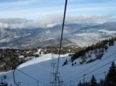
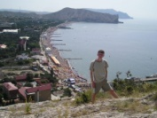
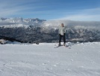
1. Introduction
Design theoretical model for event-based media content representation;
Assist a user in organization and management of the personal media collection;
Improve the quality of contextual data of the personal media collection;
Derive knowledge for a user inferring social ties of a user via semantic layer of events;
t
11/10/14
Event Based Media Management
Notes:
The main goal of the lecture is to investigate the concept of events for multimedia content indexing, organizing and management. In order to achieve this main goal, this lecture addresses a wide variety of design and technical challenges, which closely relate to the following detailed objectives:
-design theoretical model for event-based media content representation
-assist a user in organizing of personal media collection according to the context and events
-improve the quality of contextual data of the personal media collection by providing a tool for automatic spatial data reconstruction
-derive knowledge for a user by inferring social connections via semantic level of events

Slide 4
Outline
1. Introduction
2. Event-based Content Representation
3. Multimedia Event Mining
3.1 Personal vs Social Events
3.2 Personal Event Detection
3.3. Social Event Detection
4. Exploitation of Detected Events
4.1 Event-based Media Geoannotation
4.2 Event-based Social Connections Discovery
5. Conclusion
11/10/14
Event Based Media Management

Slide 5
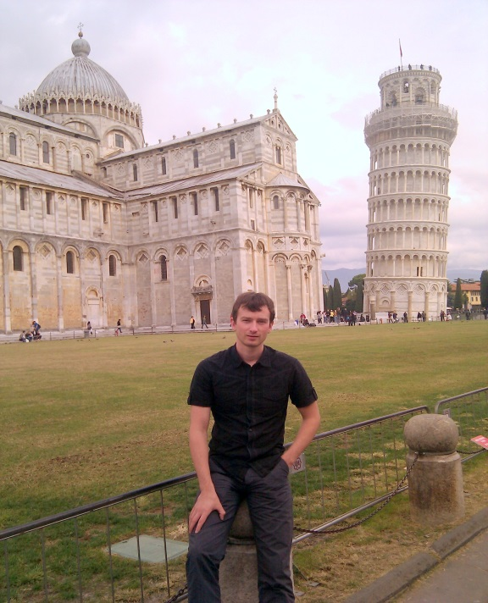
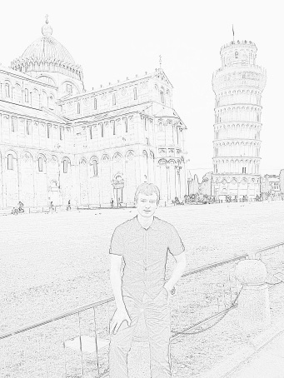
Event-Based Content Representation
Content description:
Context:
Time:24.10.2010 14:38:12
Person: John Smith
GPS Coordinates: 43.718264, 10.401993
Location: Pisa tower
Camera model: NexusOne Focal length: 4.3mm
Event: MM’10 Conference
Sub event: trip to Pisa
Low level description:
Color histogram:
Shape:
11/10/14
Event Based Media Management
Notes:
In order to better understand the problem for event-content representation let’s consider the following driving example. So look at the image on the right side. We can distinguish three different aspects to describe it.
1st aspect is image content description it possibly contain semantic information about the objects, persons, locations, events represented on the image.
The second aspect contains information about the environmental condition in the moment of capturing the image. It includes spatio-temporal information and camera settings information.
And finally the information about low level features of an image is presented. Low level description aspects contains information about color histogramm, shapes, etc.

Slide 6
Event-Based Content Representation
Different aspect of media description and their coverage by different media standards and models:
IPTC IIM
Photo parametric information (Context description)
EXIF
XMP
VEML
Semantic information (Content description)
DIG35
SSVM
CRM
MPEG7
Low level description
11/10/14
Event Based Media Management
Notes:
In order to find the appropriate model that can cover all the presented informational aspects we have analyzed existing standards and models related to this task. As you can see from the presented image we differentiate informational aspects by three circles and locate on them these standards and models. The analysis of the existing standards demonstrates the absence of appropriate to our needs model.

Slide 7
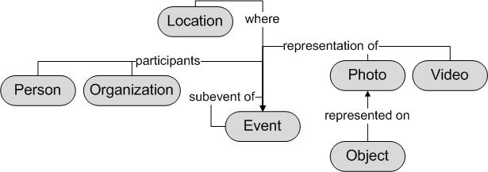
Event-Based Content Representation
Example of simplified entity-oriented model for event and media management.
11/10/14
Event Based Media Management
Notes:
To this end we propose a novel entity-oriented model for event-content representation. The crucial role in this model plays entities and relationships among them. All the entities are organized in classes. The classes that we call entity types (or simply Etypes) are defined according to their nature that is defined by the inherent set of attributes, relations to other Etypes and services under them. Personally I was responsible for media Etypes (Image, Photo, Video and Video File etypes). You can see on the slide a simplified lattice of different Etypes. Those Etypes are organized in the hierarchy with parent-child relationship, where any Etype inherits all the properties of its ancestor. I would like to emphasis that we distinguish between Mind product and Artifact, I will describe this on the next slides. Here you can see the simplified example of event-content model representation where etypes and the relationship among them are depicted. Ok now lets return to our driving example and describe how it fits our model.

Slide 8
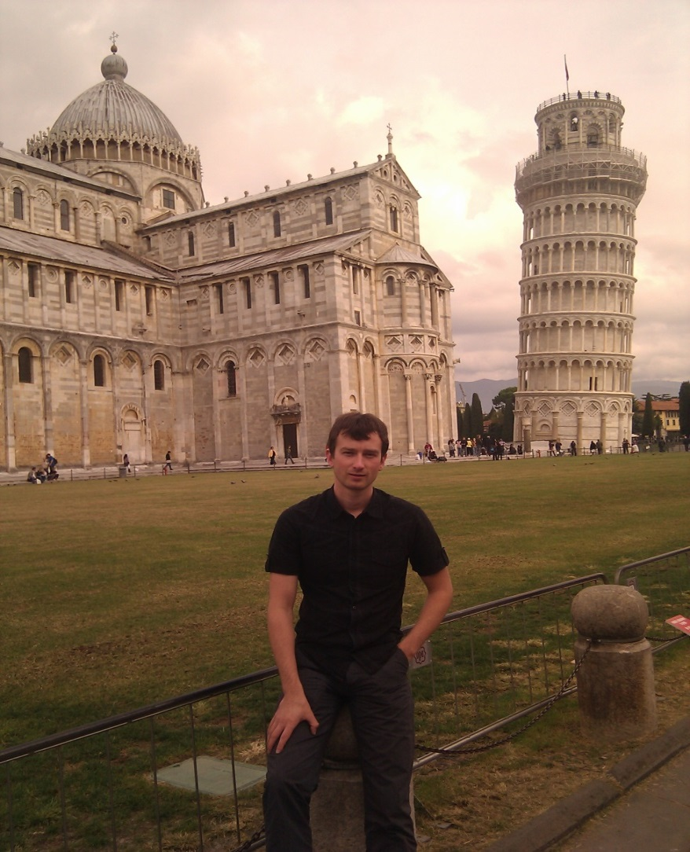
Event-Based Content Representation
Image Etype describes
Basic Information
Low-level features
Photo Etype describes
Camera settings
Geographical attributes
Content attributes
Outline
a region of interest (ROI) on the photo is specified as a bounding box by a user or the system.
Example of Photo Content description.
11/10/14
Event Based Media Management
Notes:
As I already mentioned there are Image and Photo Etypes, where Photo is a child of Mind Product and Image Etype is a child of File Etype – in order to understand this distinction better just consider them as Content and Container accordingly. So let me desribe them in more detail way. Image Etype contains attributes that describes basic information about image entity such as height, width, color model, etc. Moreover this Etype also contains all the information related to low-level description of an image: color histograms, textures, shapes, etc.
This organization allows us to cover all the informational aspects: semantic information, photo parametric information and low level description.

Slide 9
Outline
1. Introduction
2. Event-based Content Representation
3. Multimedia Event Mining
3.1 Personal vs Social Events
3.2 Personal Event Detection
3.3. Social Event Detection
4. Exploitation of Detected Events
4.1 Event-based Media Geoannotation
4.2 Event-based Social Connections Discovery
5. Conclusion
11/10/14
Event Based Media Management

Slide 10
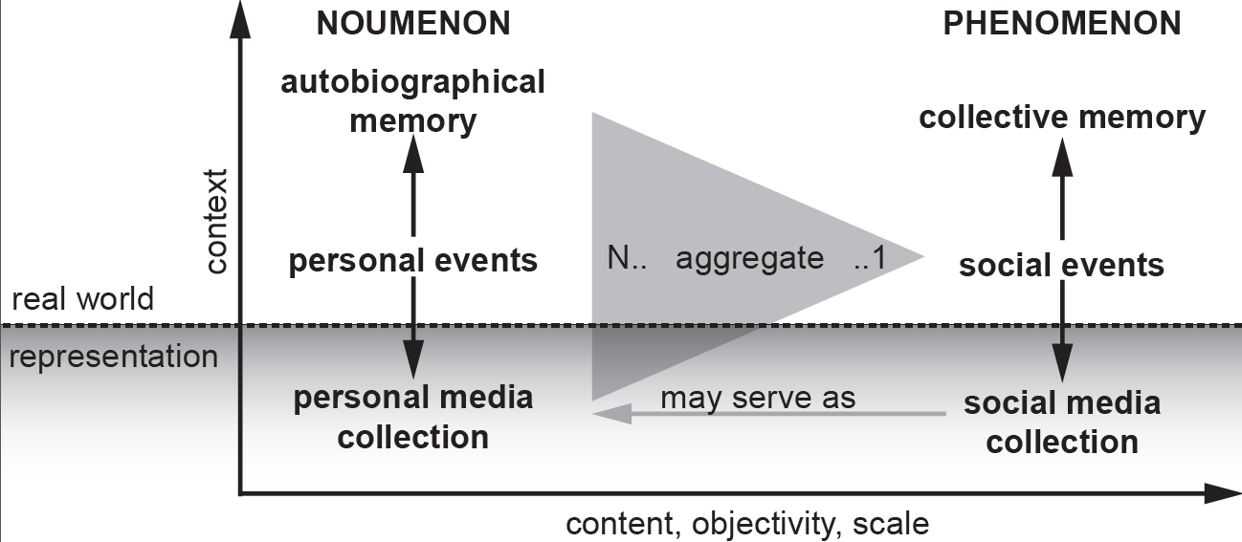
3.1 Personal vs Social Events
Distinction between personal events and social events
11/10/14
Event Based Media Management
Notes:
Personal events are put into context and are stored in our autobiographical memory. In this sense, we refer to our personal experiences as noumenon in the sense of Kant: a personal, possibly inexpressible, reality, that is the sum of personal reasoning in attempting to understand the world in which we exist. In the course of producing and collecting personal media, people try to represent the memorable events. Unfortunately, the representations are not able to provide the full context of these memories.
In contrast, social events are phenomena aggregated by multiple personal events. Social events build the basis for the collective
memory, our common denominator for social communication. Since personal media is shared between people who are either
participating or interested in specific social events, social media collections are built. Similar distinction related to events and memories have been done in psychological studies.

Slide 11
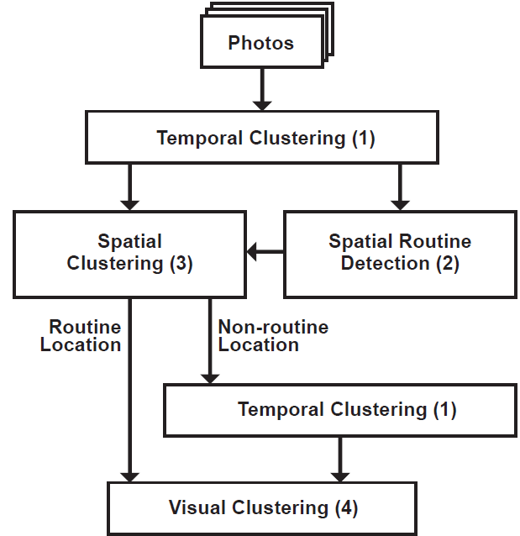
3.2 Personal Events
Algorithm of hierarchical clustering
(1): Temporal Clustering
(2): Spatial Routine detection:
(3): Spatial clustering
(4): Visual Clustering
for each location compute the number of days in which photos was taken. The maximum number indicates routine loc
ation.
11/10/14
Event Based Media Management
Notes:
Ok now I will describe you personal event detection approach. By personal event detection we imply defining the spatio-temporal boundaries of an event. To this end we extract the timestamp and GPS coordinates for each photo in the media collection. The first step of the algorithm clusters chronologically ordered images on temporal basis, the temporal gaps between them we consider as boundaries between clusters. Usually 10-hour temporal gap is enough to make a new event-cluster. Similar approach we employ for spatial clustering. Spatial routine detection allows us to detect the routine location or locations of a user. And here we made an interesting assumption if an event has happened in a non-routine location it is a signal that this is a root-event that can have sub events. For example if you go to a conference we will define all the days within the same location where conference is as an event, and temporal gaps between these days will be the boundaries of sub events. Visual clustering is used for further fine grained divisions of clusters.
11/10/14

Slide 12
3.2 Personal Events
Multimodal Clustering (MMC)
2-means clustering
Applicable for temporal, spatial and visual clustering
t₁
t₂
t₃
t₄
t₅
∆t₁₂
∆t₂₃
∆t₃₄
∆t₄₅
Gaps between events
∆t₁₂
∆t₂₃
∆t₄₅
∆t₃₄
11/10/14
Event Based Media Management
Notes:
On this slide I will describe the clustering method. We call it Multimodal clustering because it is used for any type of data(temporal, spatial, visual) in our approach. This approach exploits well known k-means clustering technique, however in our case we always use k equal to 2. The important prerequisite is to sort images in chronological order. I show you example on the temporal clustering, but as I’ve already mentioned it can be also spatial or visual. Then we compute between them distances, and cluster the big distances in one cluster and small in another. The cluster with big distances we treat as event separators.
11/10/14

Slide 13
3.2 Personal Events
Dataset
6 users
~42 000 images
726 folders (events) arranged by users, with 125 subevents
Average duration per user 6.36 years
Movement per user 116245.3 km
11/10/14
Event Based Media Management
Notes:
In order to validate our approach we collect the dataset that consists of 42K images from 6 different users. Users unintentionally arrange 726 folders which we treat as events. Note that we disregard few albums that contains images like “My favourite” or “Portrait of my children”. So average duration of the collection for a user equals to 6 years and 4 months.

Slide 14
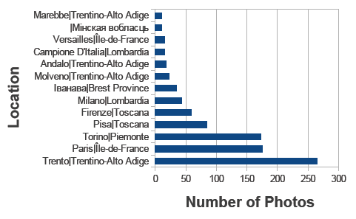
3.2 Personal Events
Distribution of photos per location
(Locations acquired by reverse geocoding)
11/10/14
Event Based Media Management
Notes:
Here the results. This slide demonstrates the distribution of images per location. We show it in order to demonstrate the robustness of routine location detection
11/10/14

Slide 15
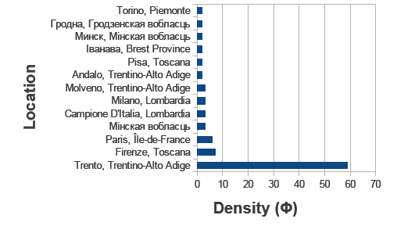
3.2 Personal Events
Density(Ф) of days with photos taken per location
Home
11/10/14
Event Based Media Management
Notes:
And here is the our approach for detection routine. It was detected correctly.
11/10/14

Slide 16
3.2 Personal Events
 | Precision | Recall | F1-Measure
Time [1] | 54.11 | 82.65 | 62.57
Spatial | 78.65 | 36.84 | 46.48
Visual | 6.68 | 68.96 | 11.68
Combined approach | 80.35 | 73.36 | 74.56
Proposed approach | 81.01 | 81.7 | 81.35
Temporal MMC [1]
Spatial
clustering
Visual
MMC
Combined
approach
Proposed
approach
Experimental results for automatic event detection in relation to the user’s album
organization.
11/10/14
Event Based Media Management
Notes:
We have compared our results with the state of the art approach the first raw on the table. Combined approach does not exploit information about routine detection. As you can see the proposed approach performs better then other.

Slide 17
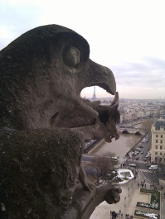
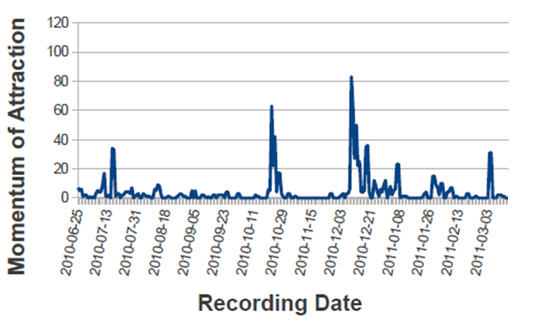
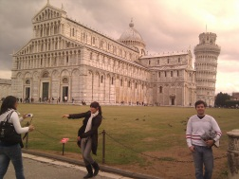
3.2 Personal Events
11/10/14
Event Based Media Management
Notes:
Another interesting results that should be mentioned is detecting of salient moment of event. We compute them by taking a second derivatevs from temporal distances and find out that when user tries to capture a lot of images within the small temporal interval it can be a signal that user capture one of the interesting moments.
11/10/14

Slide 18
3.3 Social Events
a) time overlap of tA and tB and
b) selecting the minimum spatial distance of all points pbj of PB to a particular point pai or PA
11/10/14
Event Based Media Management
Notes:
Now it is time to describe our approach for social event detection. As input we use spatio-temporal information about personal events. In order to detect a social event we compute the temporal intersection between personal events of two different users. If they intersects then we compute the spatial distances of the 10 closest images among two events.

Slide 19
3.3 Social Events
Crawl a Flickr with Yahoo! Upcoming machine tag “event:”
1.8 million of photos
11 180 events
4100 different users.
2007 – 2012 years.
11/10/14
Event Based Media Management
Notes:
We created a different dataset to validate our approach. It consist of 1.8 million of photos from Flickr with Yahoo! Upcoming machine tag “event” from 41 hundreds of users. They were sorted on 11 180 albums or “sets”. The photos were taken withtin 5 years period: from 2007 to 2012.

Slide 20
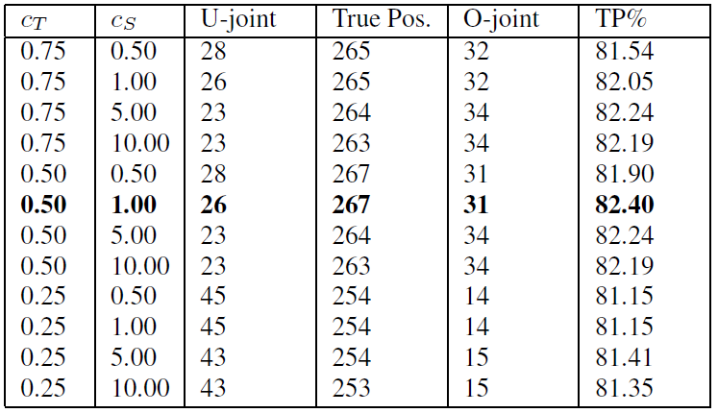
3.3 Social Events
Results for the parameter learning phase, comparing true positives against under-joint
(U-Joint) and over-joint (O-joint) social events.
11/10/14
Event Based Media Management
Notes:
And the results demonstrates that the threshold of 50% temporal intersection and 1km spatial distance demonstrates the best results where TP equals to 82.4% .

Slide 21
Outline
1. Introduction
2. Event-based Content Representation
3. Multimedia Event Mining
3.1 Personal vs Social Events
3.2 Personal Event Detection
3.3. Social Event Detection
4. Exploitation of Detected Events
4.1 Event-based Media Geoannotation
4.2 Event-based Social Connections Discovery
5. Conclusion
11/10/14
Event Based Media Management

Slide 22
4. Exploitation of Detected Events
Event-based Media Geoannotating
Exploitation of personal events for automatic geotagging
2. Event-based Social Connections Discovery
Exploitation of social events
for social ties discovery
11/10/14
Event Based Media Management
Notes:
In this section I’ll demonstrate how personal event can be exploited for automatic geotagging and how social events can be exploited for inferring social connections.

Slide 23
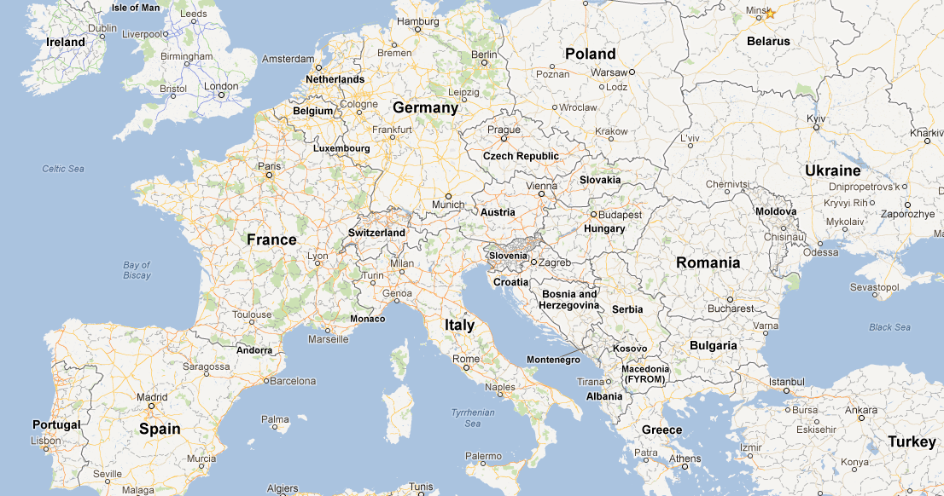
4.1 Event-based Media Geoannotation
Event centered geoannotating
based on the context of personal photo collection
11/10/14
Event Based Media Management
Notes:
Personal media collection aggregates digital images and videos from different sources such user’s smartphone, professional photo camera of a friend of a user. Some of these devices equipped with GPS sensors – some not. As the result the partial loss of geo information within personal media is observed. However recent studies has shown that spatial modality plays important role for sorting and organizing of personal media collection. To this end we propose a robust techniques for context-based reconstruction of missing geo data of digital photos via the sematic layer of event.
11/10/14

Slide 24
4.1 Event-based Media Geoannotation
Interpolation: the process of estimation of a unknown sequence of samples within two known data points
Extrapolation: the task of extending a known sequence of values
X
X
y
Extrapolation
y
Interpolation
11/10/14
Event Based Media Management
Notes:
The essence of the approach lies in using geoannotated samples and temporal distances in personal media collection to estimate geo coordinates for samples without GPS stamps. To do this we employ interpolation and extrapolation methods. Where interpolation stands for estimating of a unknown sequence of samples within two known data points. Extrapolation extends the known sequence of values
11/10/14

Slide 25
4.1 Event-based Media Geoannotation
MMC temp clustering [1]
1
∆t
Extrapolation
2
Interpolation
3
11/10/14
Event Based Media Management
Notes:
Now I’ll describe the approach in detail. Consider the following example there is a set of images represented here by colored and black and white pins, Where color pins represents geoannotated images and black and white are images without gps information. On the first step we separate the dataset by temporal information on the set of event-related clusters. Within the event cluster we exploit extrapolation method or interpolation method. However, the problem when event cluster does not have any geoannotated samples exists. In this case user involvement is required.

Slide 26
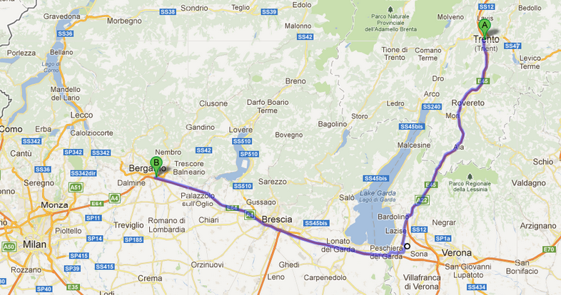
4.1 Event-based Media Geoannotation
Interpolation with free online navigation service:
11/10/14
Event Based Media Management
Notes:
In order to achieve higher precision we employ free online navigator. This allows us to compute location based on the time information with respect to the real routes and avoid such a problem as you can see on the image. Just a simple usecase taking a photo at the middle of the route from Trento to Bergamo will be close to Verona. However without navigation the system will show estimate this place as a middle of this route.
11/10/14

Slide 27
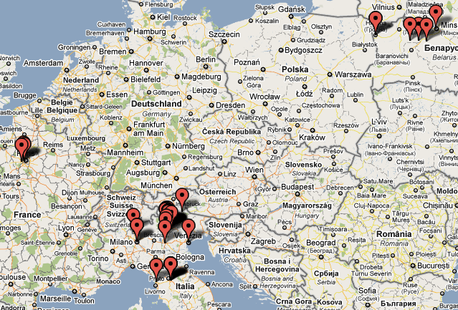
4.1 Event-based Media Geoannotation
1615 images
Taken from 25.06.2010 to 11.04.2012 (21,5 months)
901(55.79%) images with GPS coordinates (6 countries, 33 cities and towns)
Images taken by Google Nexus One smartphone.
Ground Truth: manual annotation of the owner of the collection.
11/10/14
Event Based Media Management
Notes:
So in order to validate this approach we used the dataset that consist of 1615 images that are taken within 21,5 months.
Around 55% of these image where automatically geoannotated by the GPS sensor of the smartphone. In order to provide Ground truth the owner of the collection have been asked to annotate the dataset manually.

Slide 28
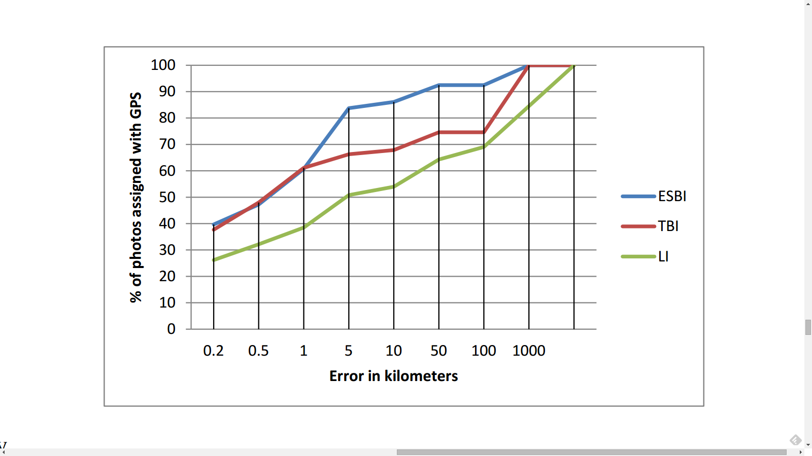
4.1 Event-based Media Geo-annotation
Experimental results
11/10/14
Event Based Media Management
Notes:
Here you can see the results. We compare our approach with linear interpolation(green color) and time-based interpolation(red color). We use as the input parameter for linear interpolation is the number of the samples. For time linear interpolation we use temporal distances between images as input parameter. As you can see the proposed approach is able to annotate more than 80% of images with an 5km error.
11/10/14

Slide 29
4.2 Event-based Social Connections Discovery
The higher the number of co-attended event between two people, the higher the probability of being acquainted.
event
11/10/14
Event Based Media Management
Notes:
Ok now I’m going to show you how we exploit social events for interpersonal ties discovery. We made a simple asssumpton the higher the number of co-attended events between two people – the higher the probability for them of being acquainted. To prove this hypothesis the dataset for validation of social event detection methods.

Slide 30
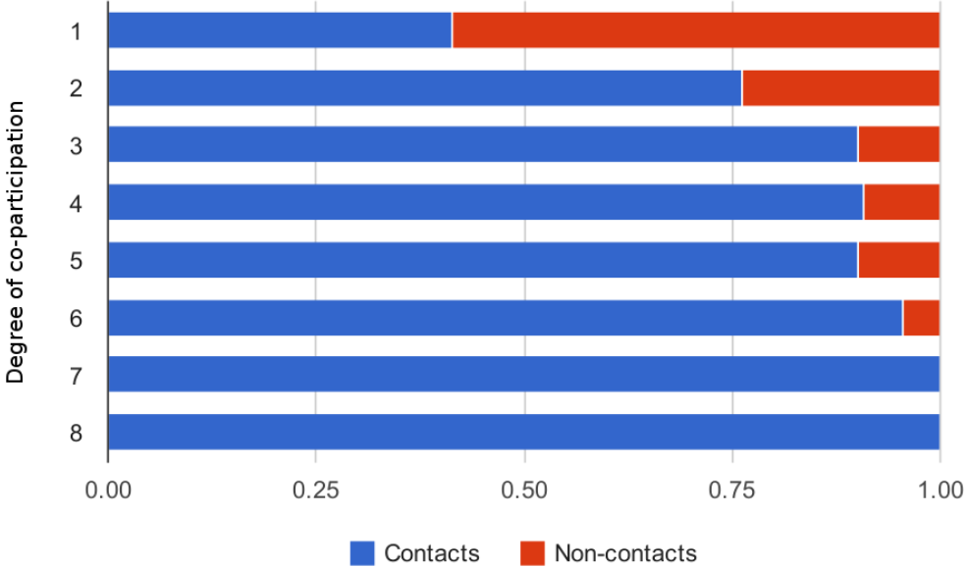
4.2 Event-based Social Connections Discovery
Ratio of users with social ties vs. users without social ties per degree of co-participation in the same events.
11/10/14
Event Based Media Management
Notes:
The results have proved our hypothesis. The dependency of social events and social ties showed on this image. The analysis of the dataset shows that two users know each other in more than 76% of the cases if they co-participated in at least 2 events.

Slide 31
Outline
1. Introduction
2. Event-based Content Representation
3. Multimedia Event Mining
3.1 Personal vs Social Events
3.2 Personal Event Detection
3.3. Social Event Detection
4. Exploitation of Detected Events
4.1 Event-based Media Geoannotation
4.2 Event-based Social Connections Discovery
5. Conclusion
11/10/14
Event Based Media Management

Slide 32
5. Conclusion
Design event- content representation model;
Design, implement and validate event mining tools from multimedia collections;
Improve the quality of contextual data of the personal media collection via the spatial context reconstruction;
Derive knowledge for a user inferring social ties of a user via semantic layer of events;
ONR project
11/10/14
Event Based Media Management
Notes:
We investigate Event Based Media Management paradigm for organizing and management of personal and social media collection. This work includes:
design of event-content representation model,
development, implementation and validation of event mining techniques that allows us to detect spatio-temporal boundaries of events within social and personal media collections.
And finally improve the quality of contextual data and derive new knowledge for a user.
This work was supported and exploited by European and international scientific projects: Glocal, ONR, Cubrik

Slide 33
Thank you!
Questions?
11/10/14
Event Based Media Management

Slide 34
References
[1] A.C. Loui and A. Savakis. Automated event clustering and quality screening of consumer pictures for digital albuming. Multimedia, IEEE Transactions on, 5(3):390 – 402, sept. 2003.
[2] “Event detection and scene attraction by very simple contextual cues” I.Tankoyeu, J.Paniagua, , J.Stöttinger, F.Giunchiglia, Proceedings of the 2011 joint ACM workshop on Modeling and Representing Events (JMRE’2011)
[3] Sounding out Semantic Event Detection in Electronic Health Records I.Tankoyeu, J.Paniagua, , J.Stöttinger, F.Giunchiglia, Proceedings of the 7th RBC conference (RBC’2011)
[4] “Indexing media by personal events” J.Paniagua, I.Tankoyeu, J.Stöttinger, F.Giunchiglia, Proceedings of the ACM International Conference on Multimedia Retrieval (ACM ICMR’2012).
[5] “Personal photo indexing” I.Tankoyeu, J.Stöttinger, J.Paniagua, F.Giunchiglia
Proceedings of the 20th ACM international conference on Multimedia, (ACM MM’2012).
[6] “Social Events and Social Ties” J.Paniagua, I.Tankoyeu, J.Stöttinger, F.Giunchiglia, to be appeared in Proceedings of the 3rd ACM International Conference on Multimedia Retrieval (ACM ICMR’2013).
11/10/14
Event Based Media Management

Slide 35
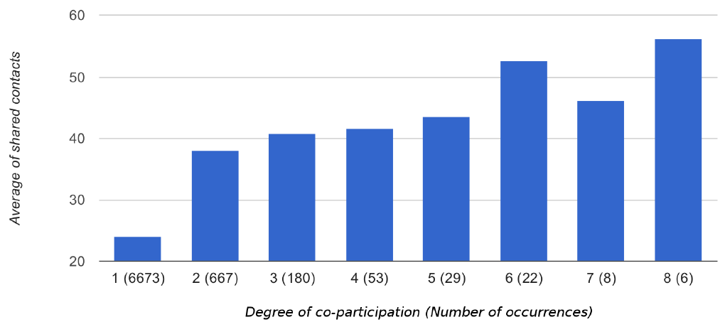
4.2 Event-based Social Connections Discovery
Shared contacts per degree of event co-participation. Included in parentheses are
the number of occurrences for pairs of users with such characteristics.
11/10/14
Event Based Media Management
Notes:
A

